Slide 1
Projects for USF CS Students 2022
By Jose Alvarado

Slide 2
Introduction
Business Owner
Engineering Manager where I manage the following projects
Swift iOS App
Node.js API on AWS
React Web App
Founded Giftata (iOS App)
Founded Zipkick (iOS/Web App)
Successful exit
Founded ThisWon (iOS App)
Co-founded with another USF student
Successful exit
Founded SF Dev Shop
Freelance projects on the side for other companies
Jose Alvarado
2015: M.S. in Computer Science from USF

Slide 3
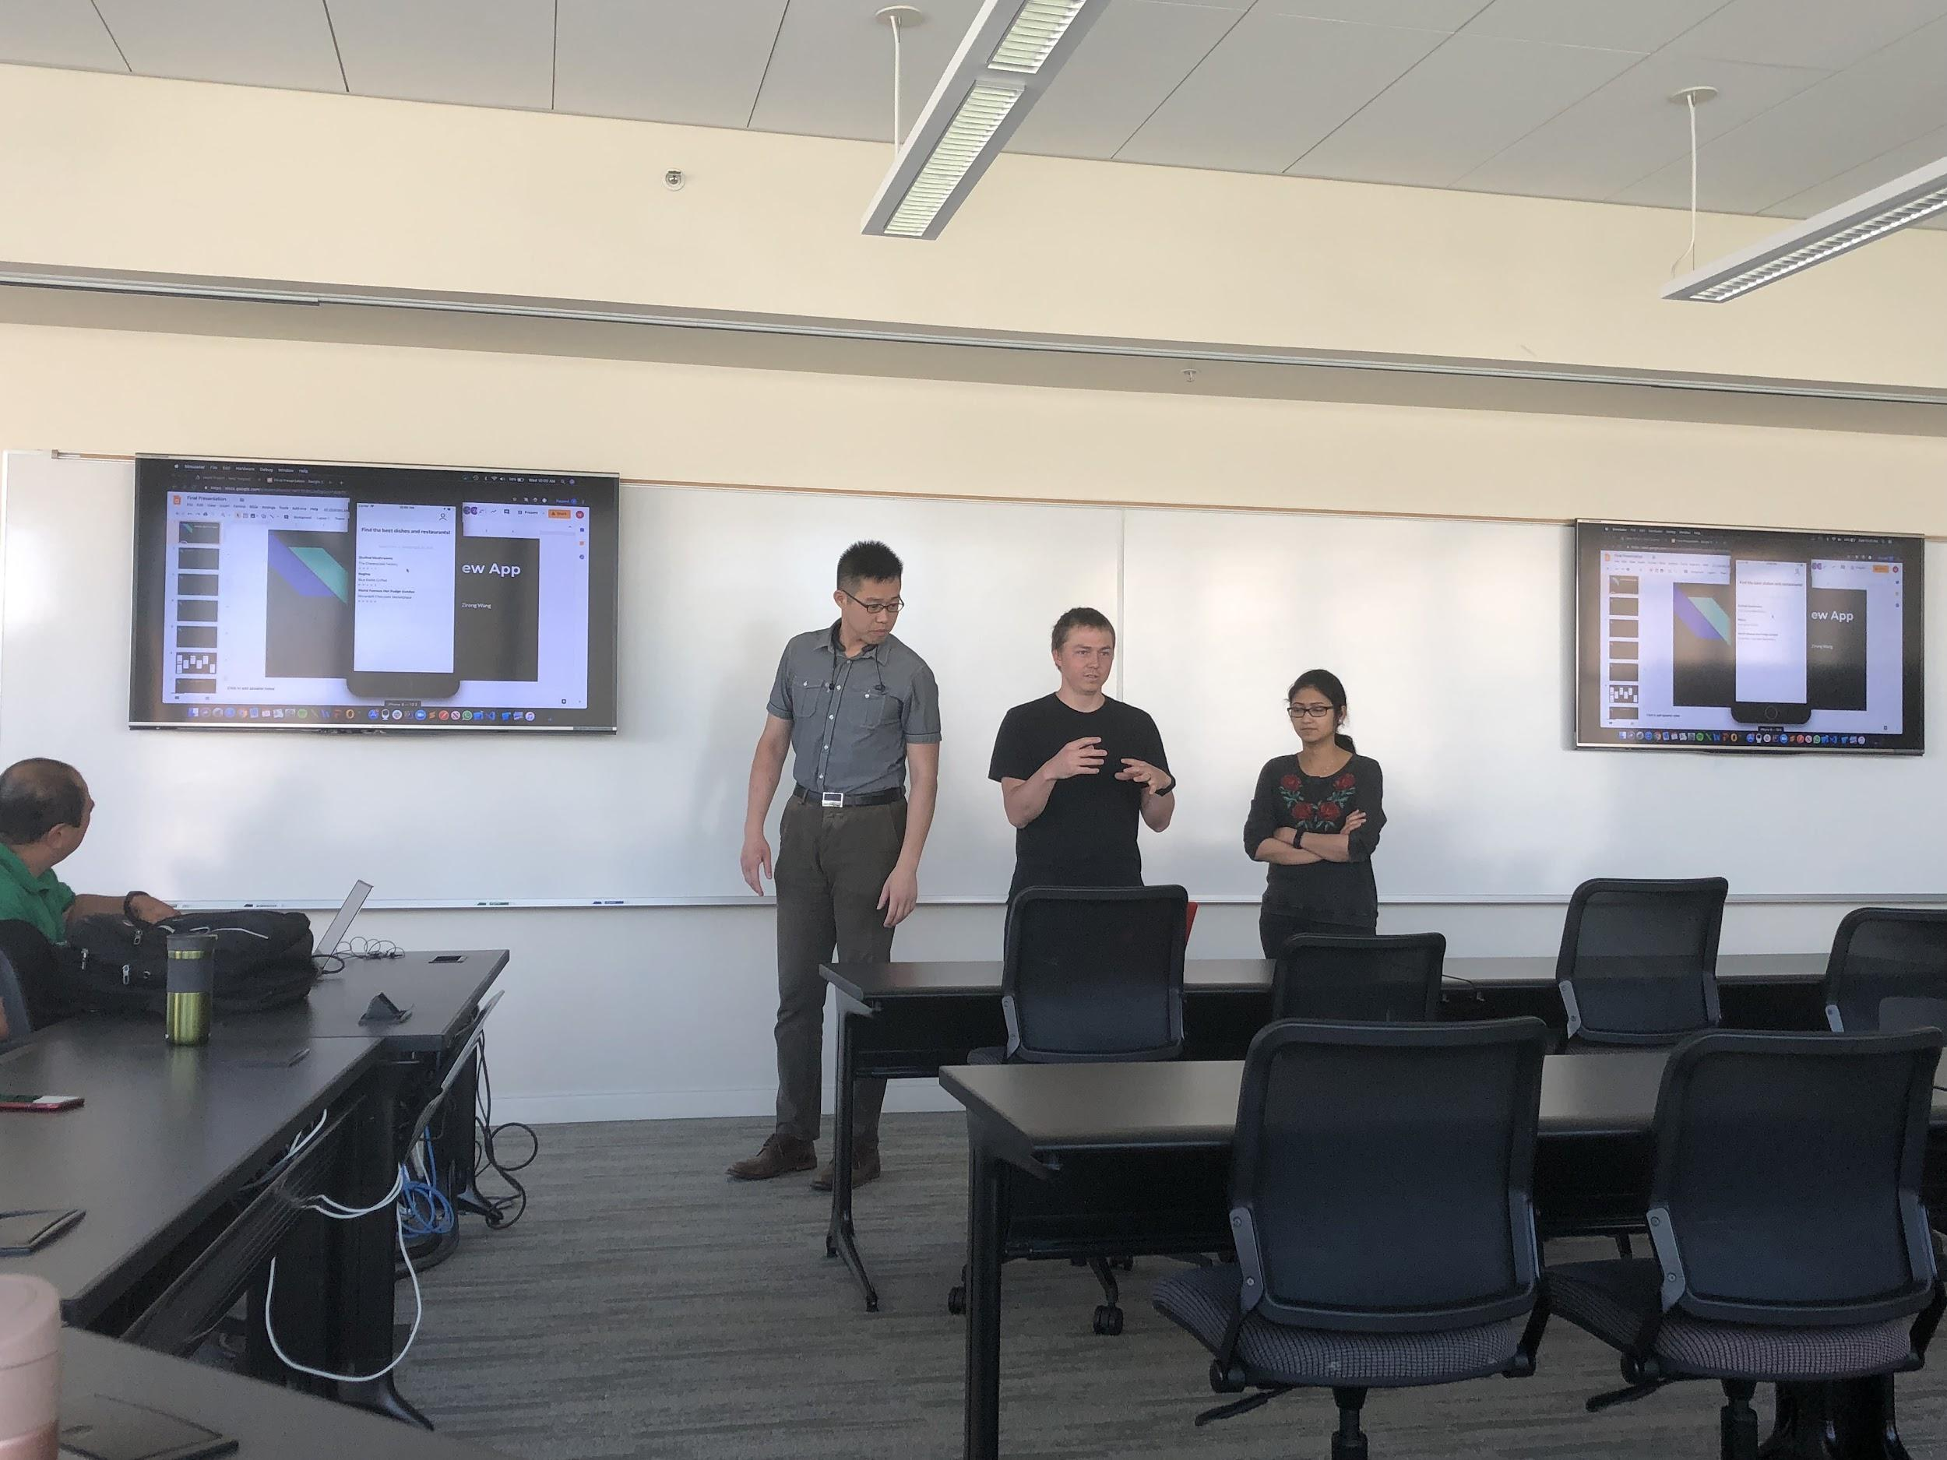
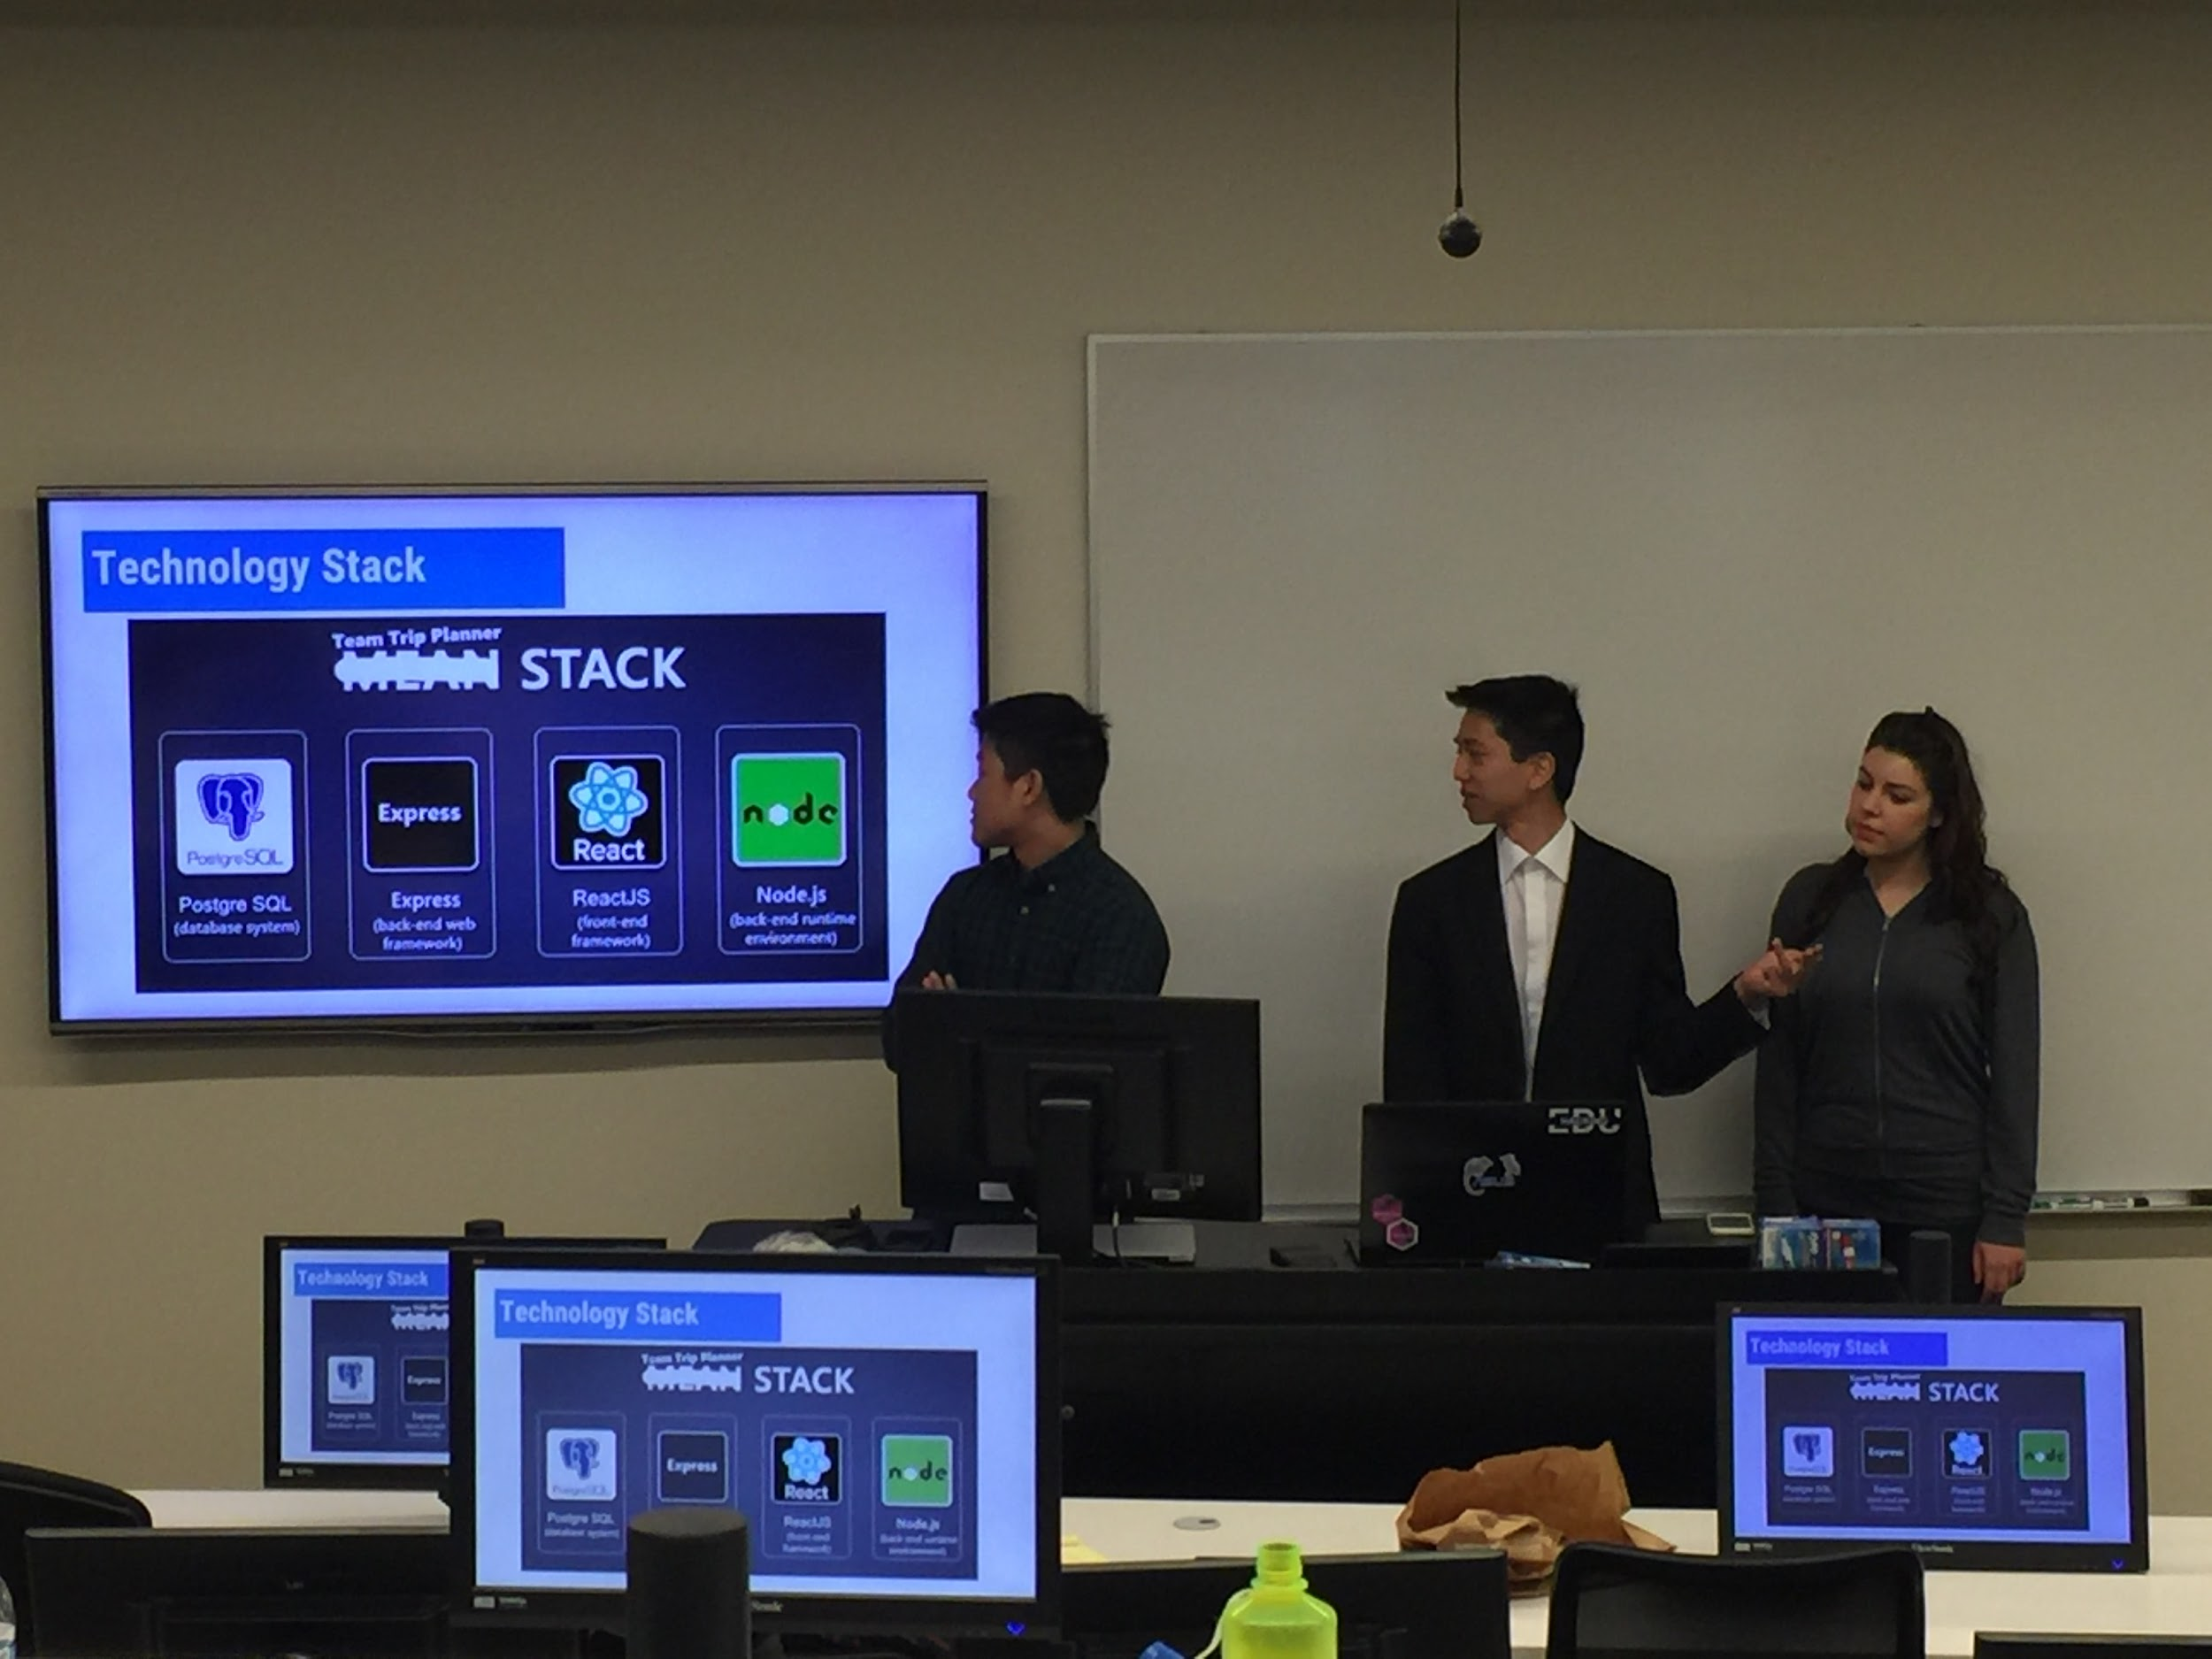
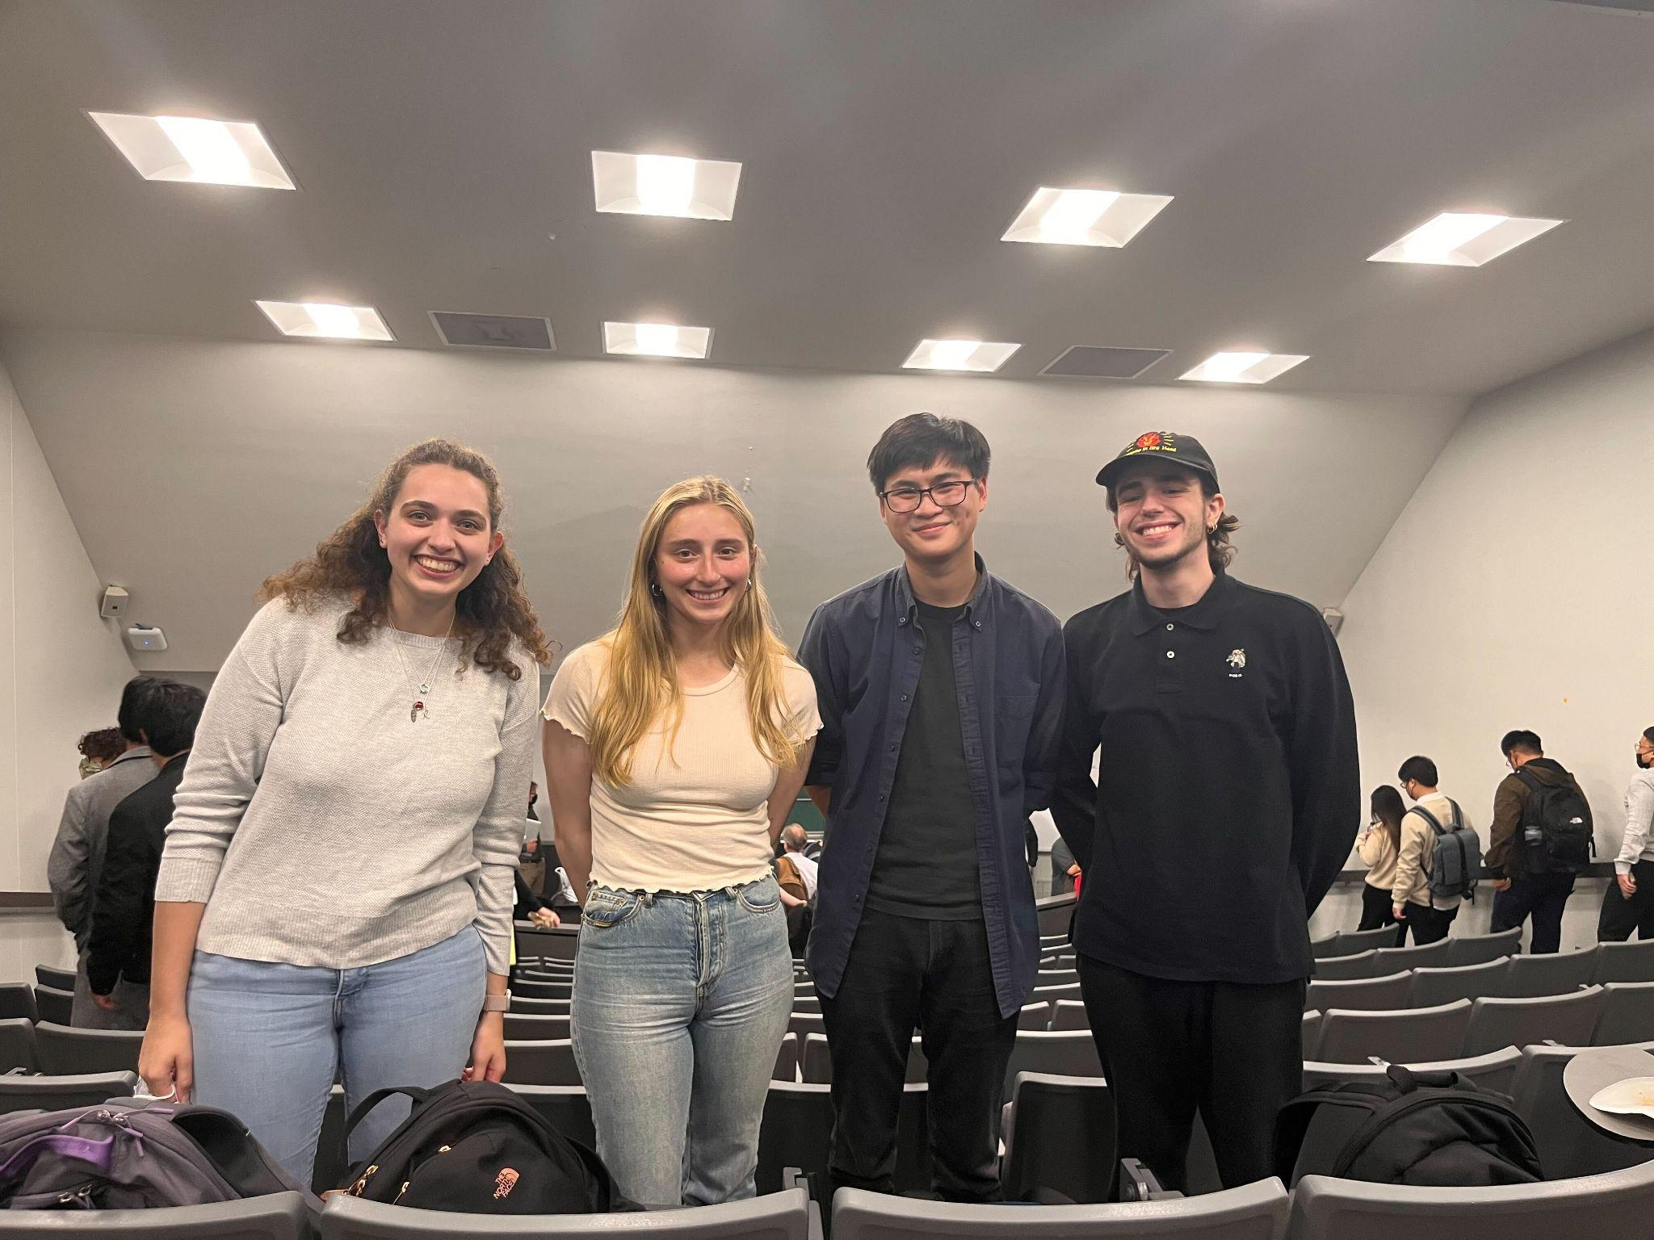
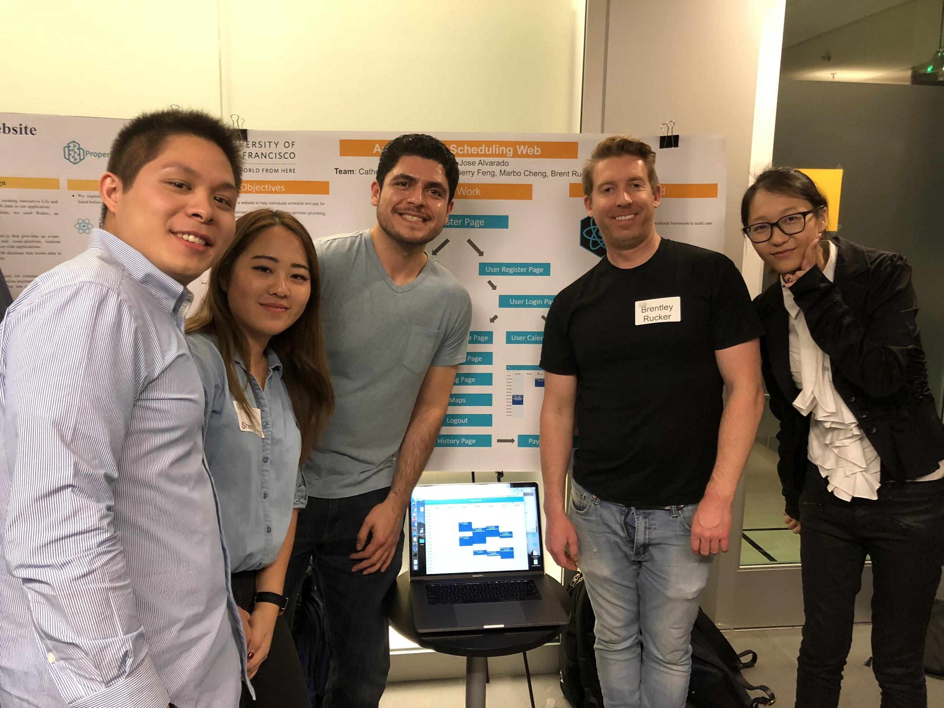
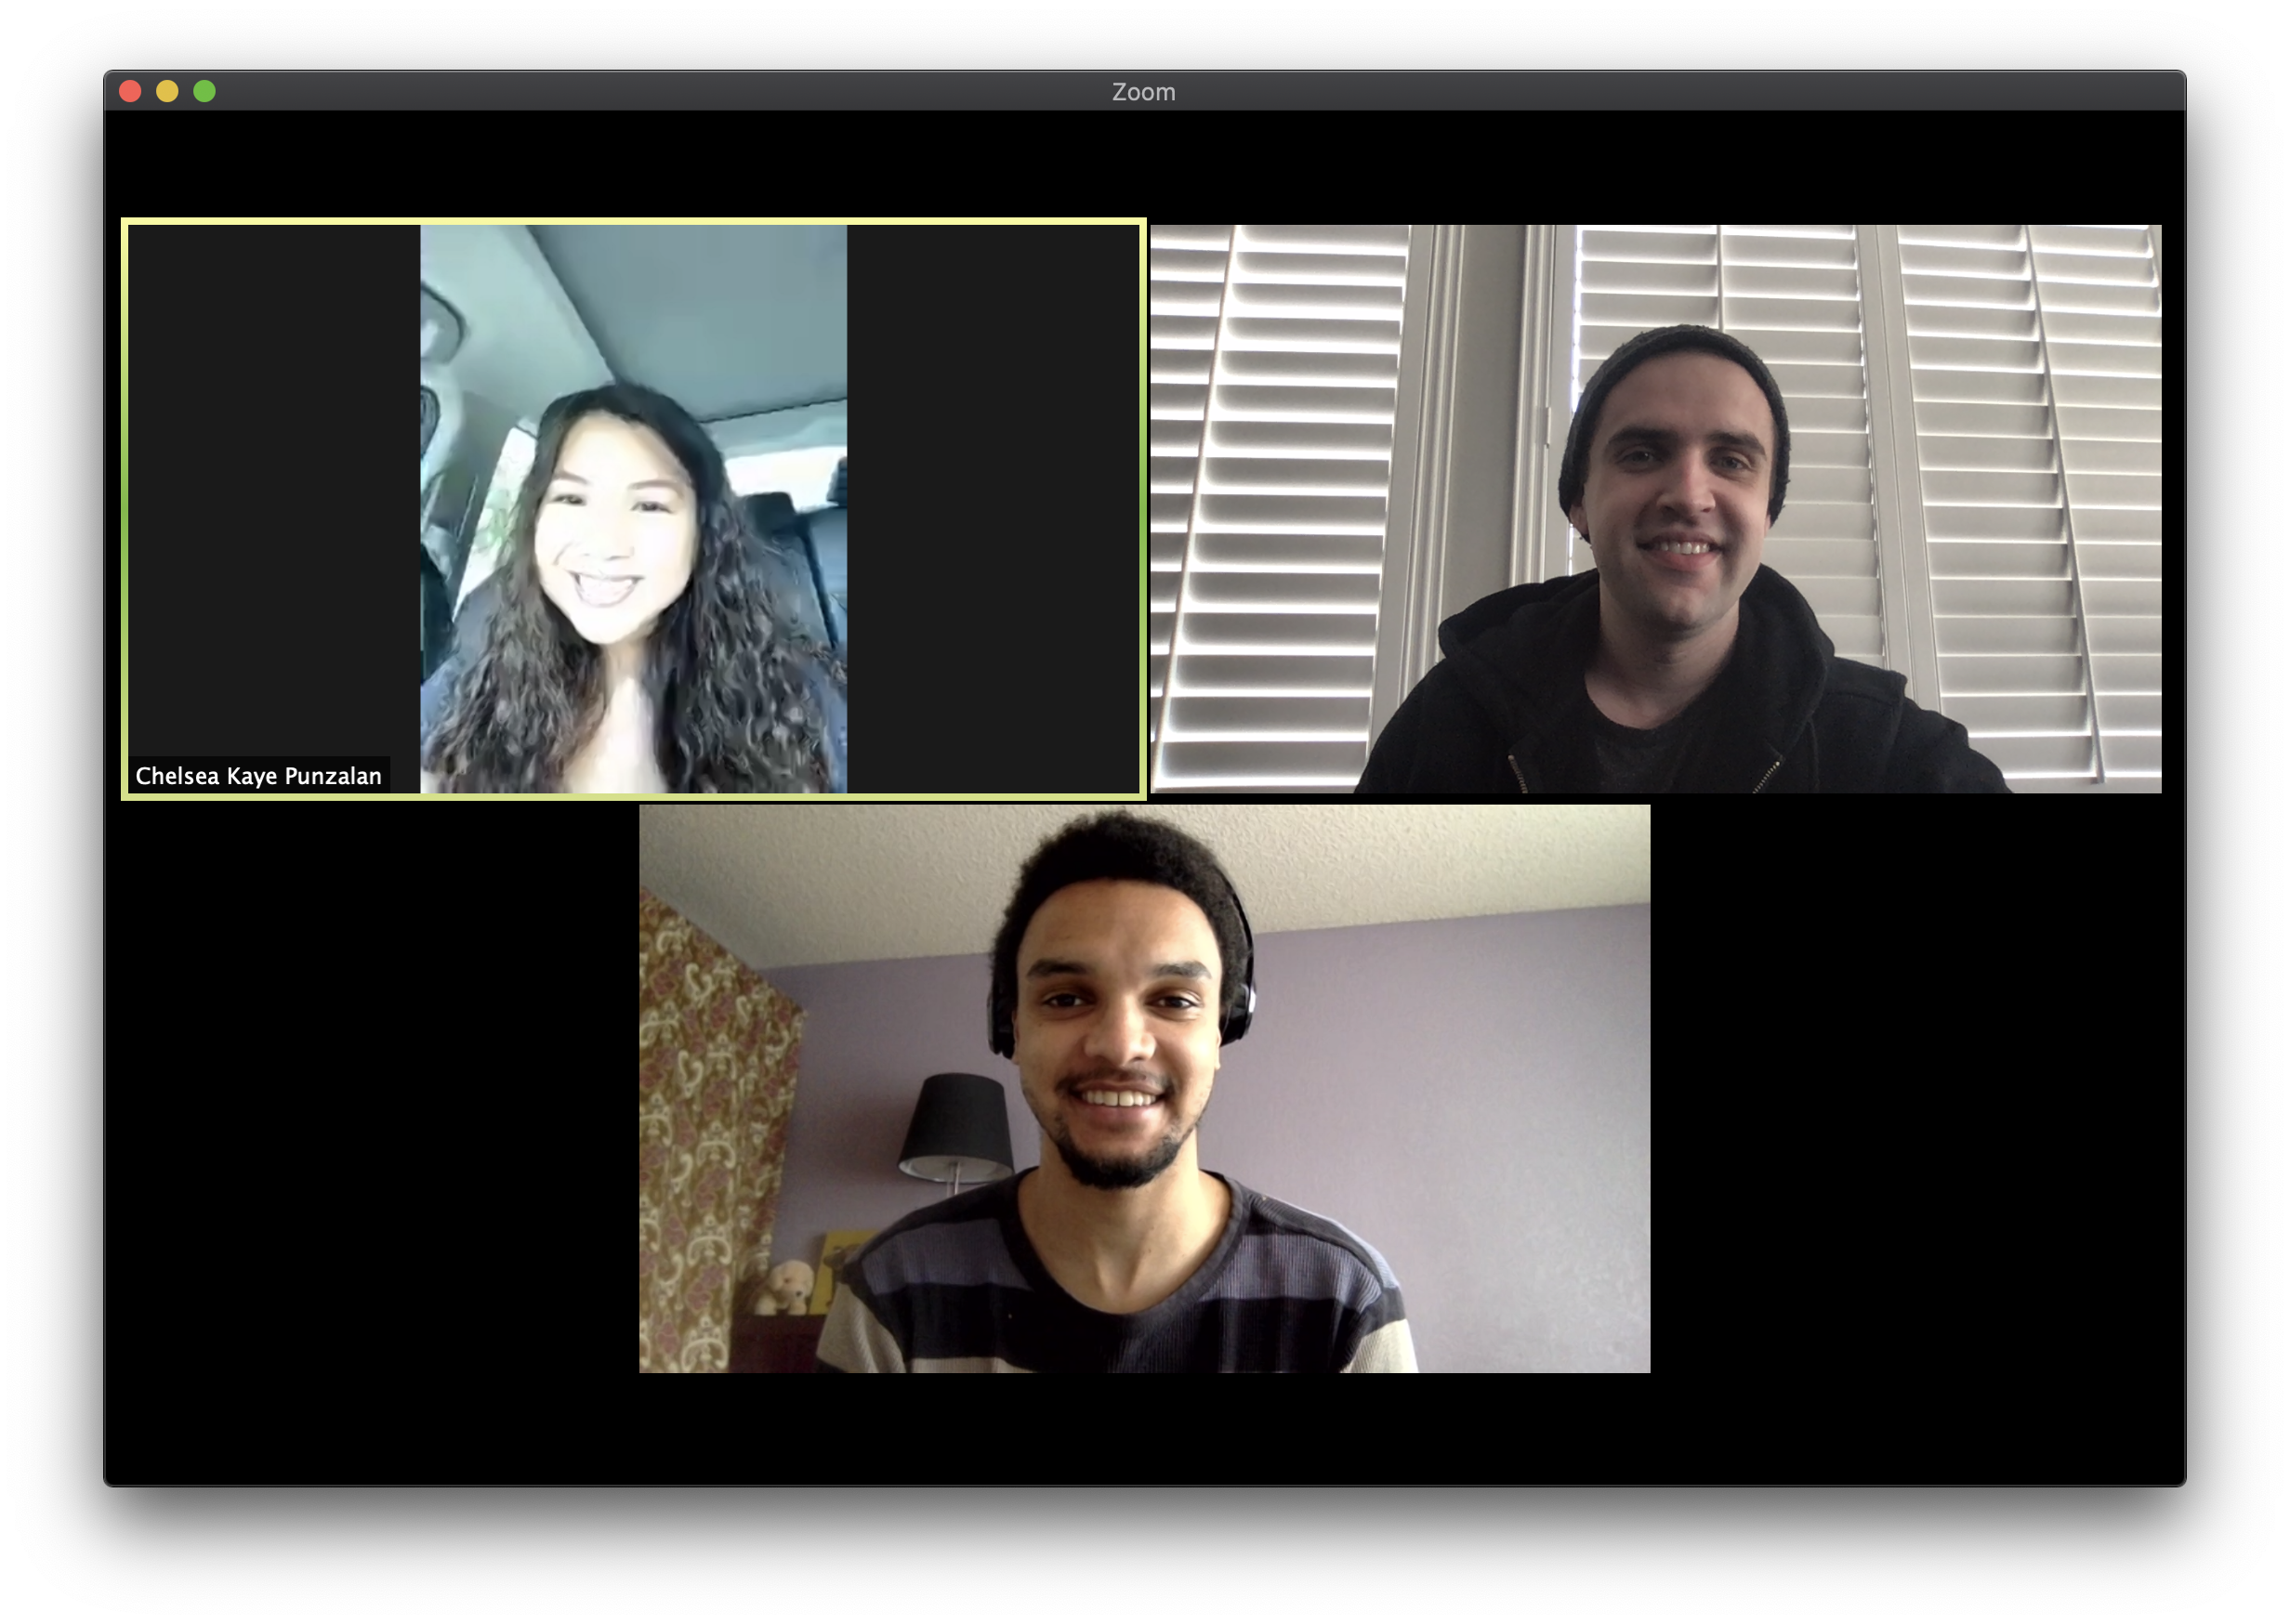
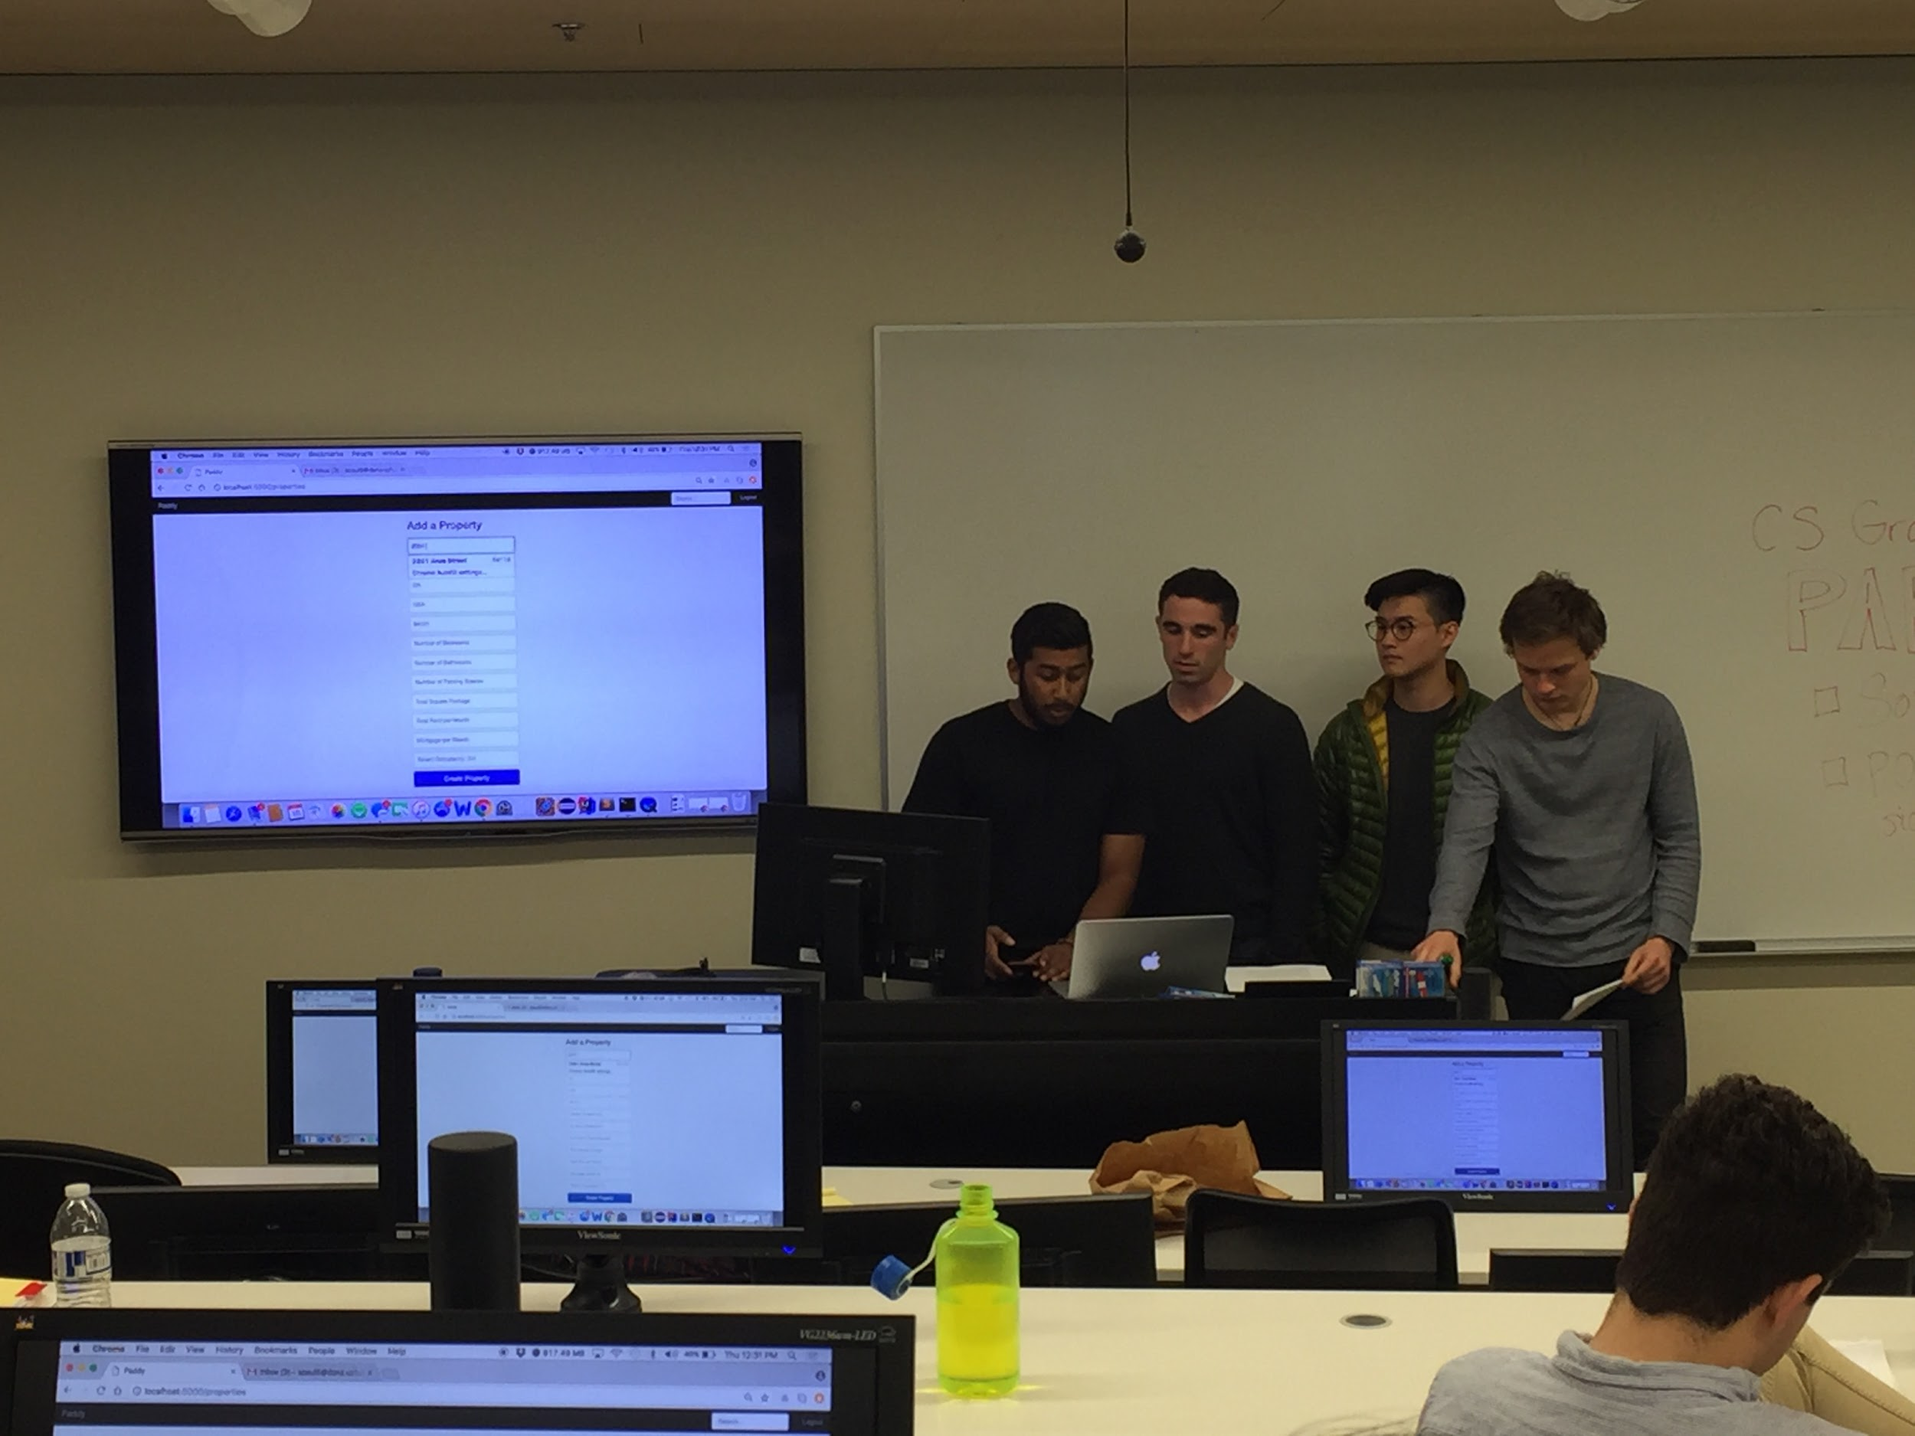
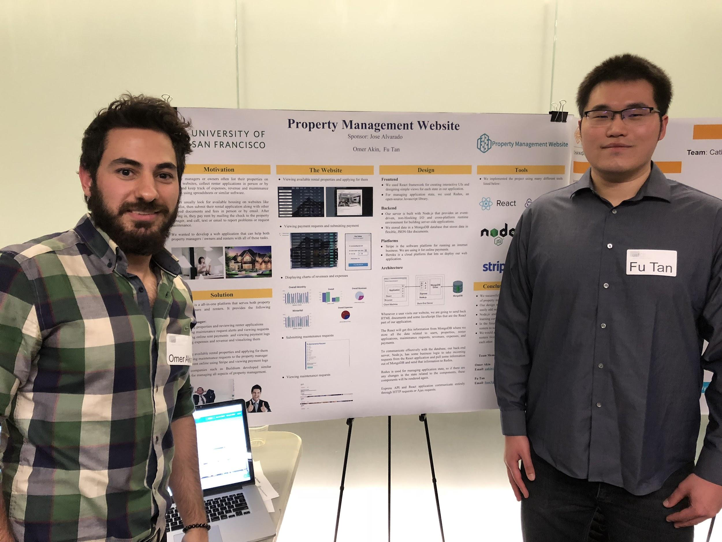
Student Stats
Feb 2017 - Present
Worked with 129 students
37 Projects

Slide 4
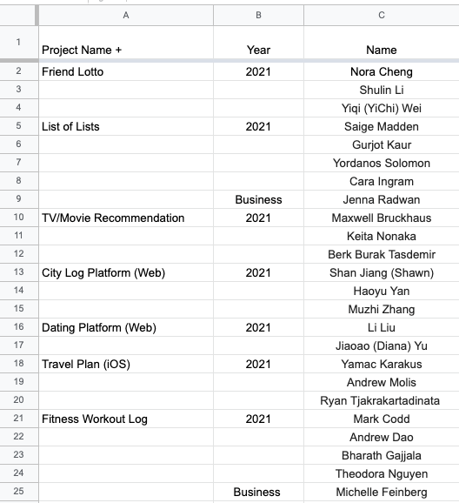
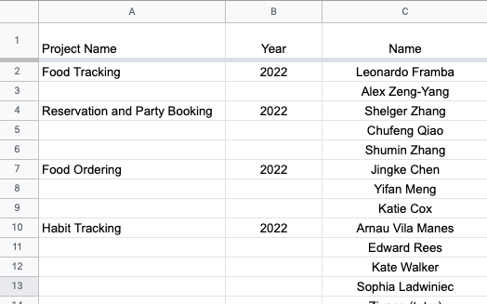
Students I worked with recently

Slide 5
Projects
Reservation and Party Booking App
Food Tracker App
Food Ordering App

Slide 6
Reservation and Party Booking App (Web)
Key Features
Create profiles for companies and customers
Companies
Create and edit packages
View purchased packages
Edit packages that only paid half up front
Customers
Purchase packages
View history
Accept payments
Allow businesses to withdraw funds
Project Goal
Allow users to buy tickets and book reservations for a variety of different events
Companies should be able to create their party packages and have a public page where customers can make purchases
Difficulty: Some packages are very complex
Customers should be able to select a package, select an available date, and customize it however they want before checking out
Reservations only require half the amount to be paid up front

Slide 7
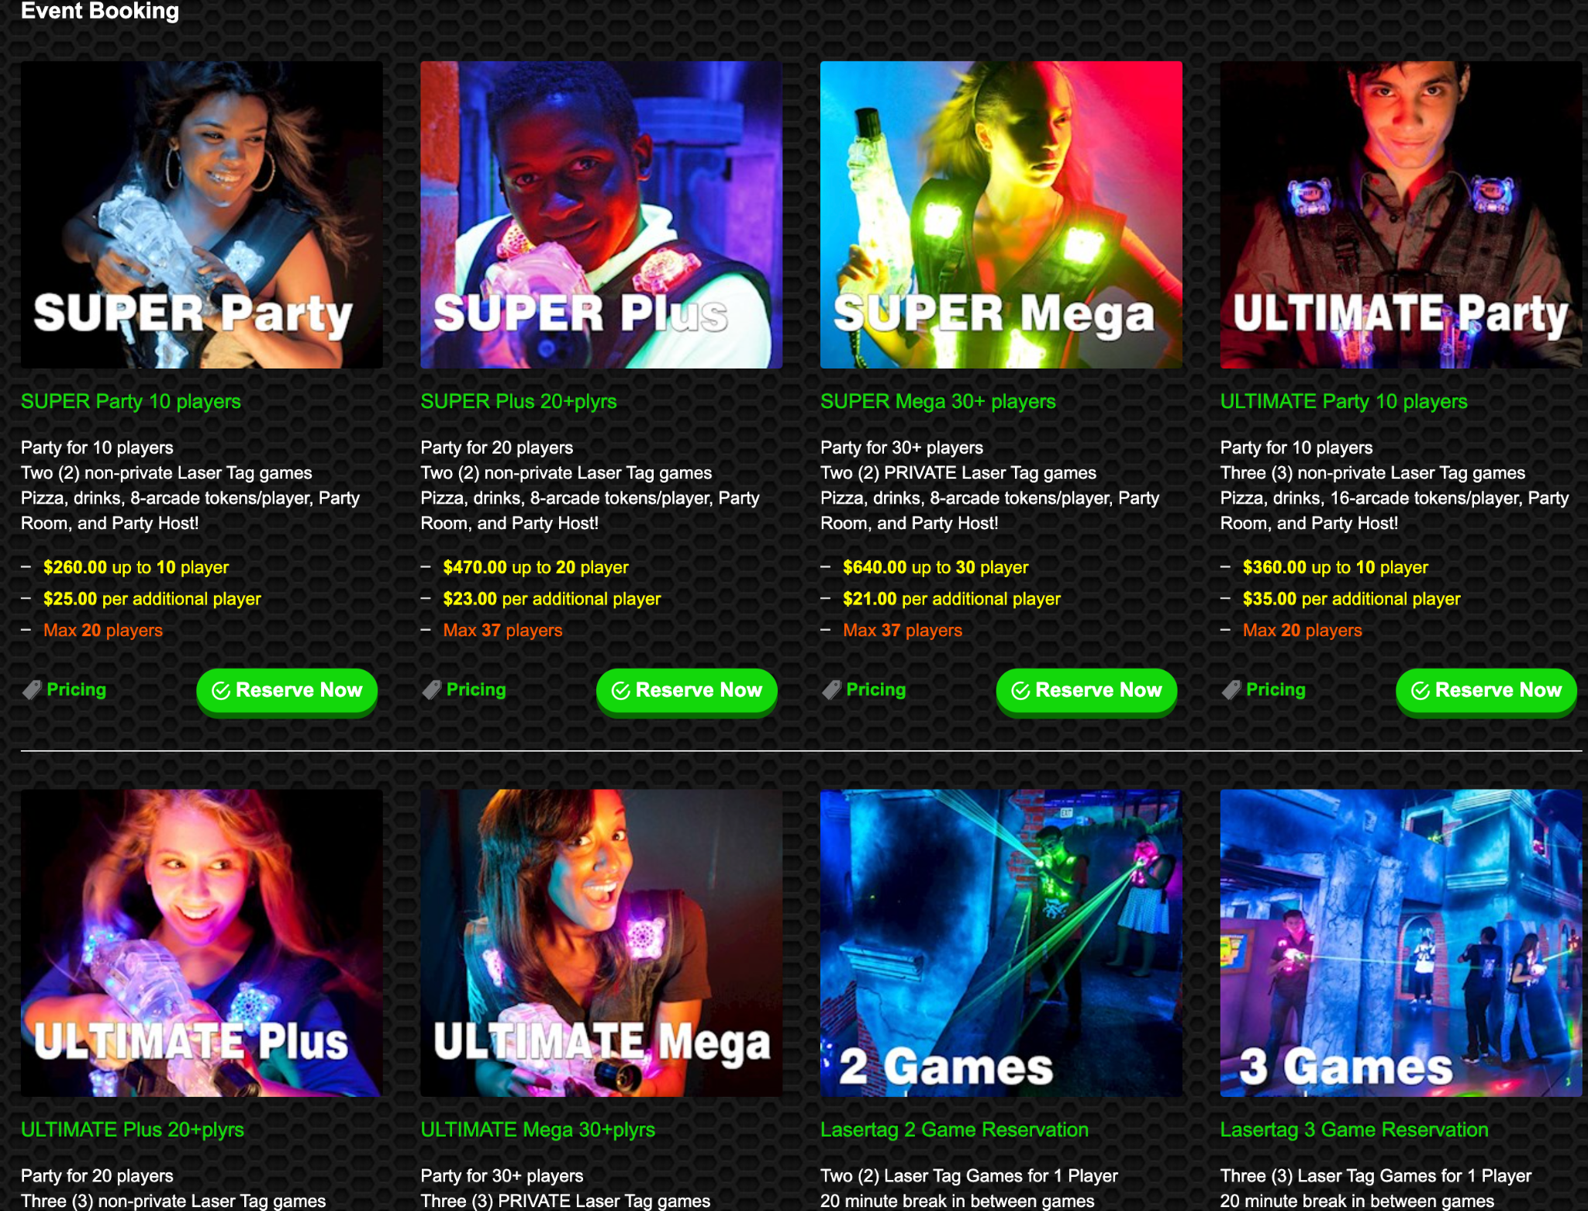

Slide 8
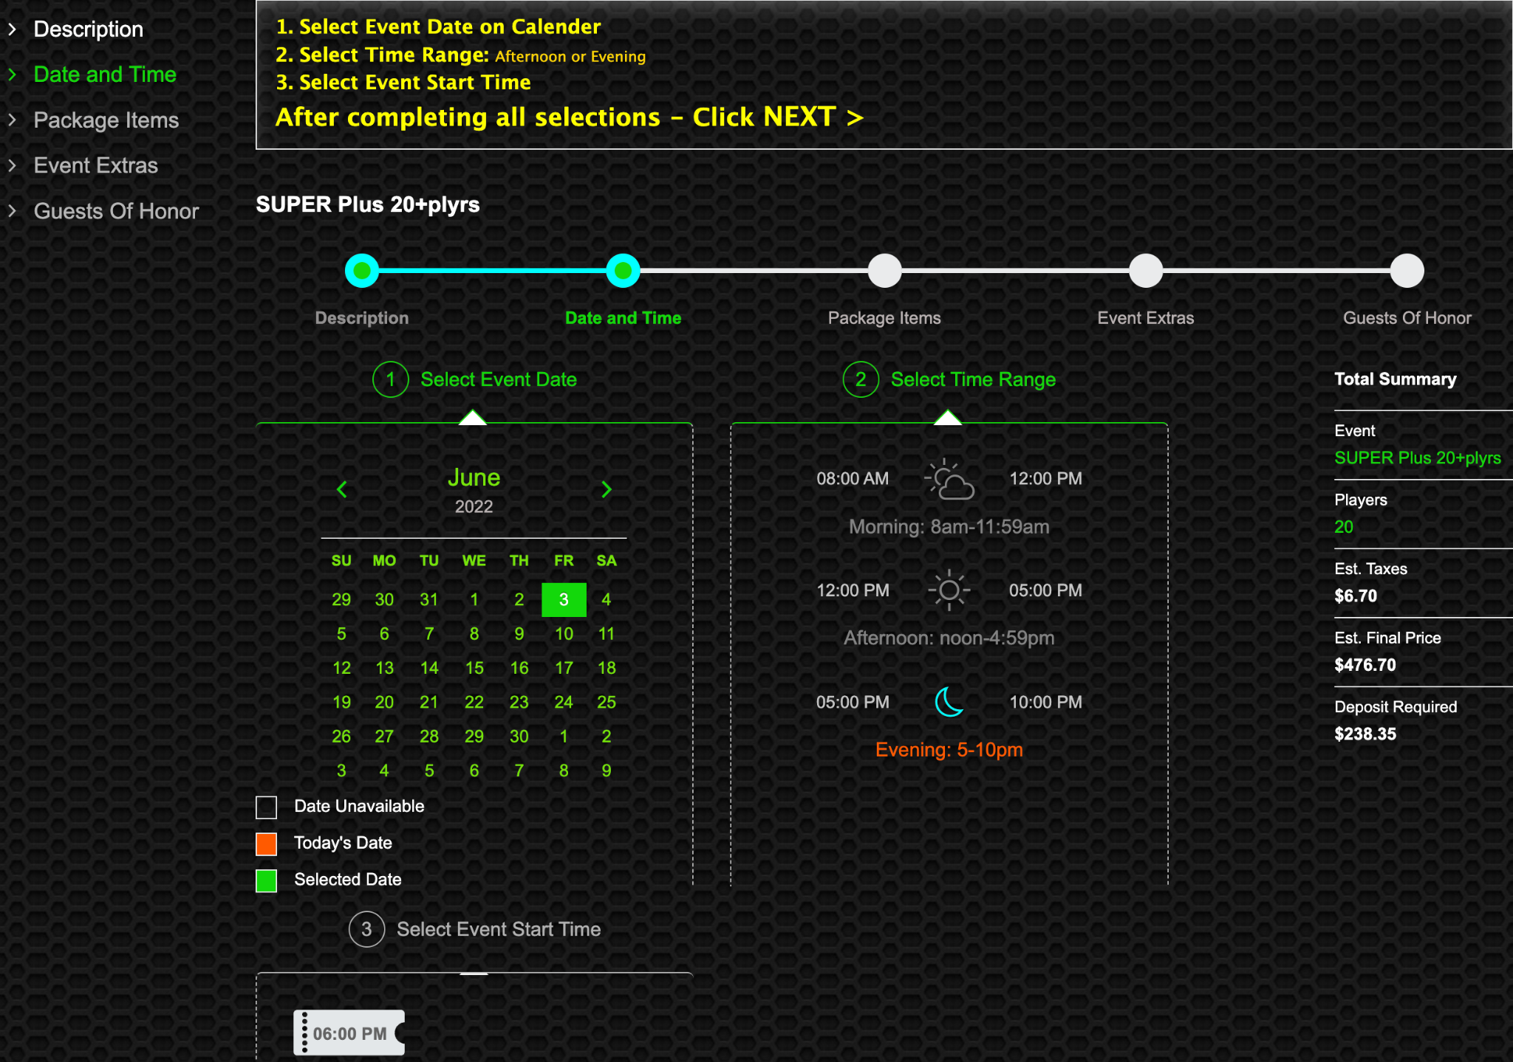

Slide 9
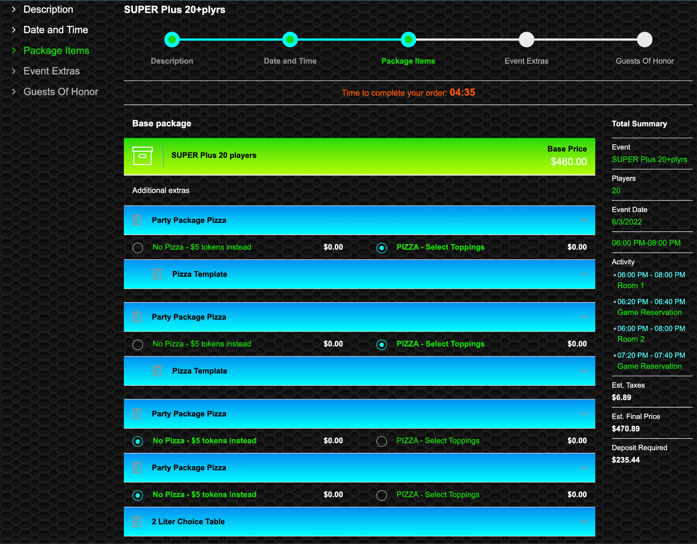
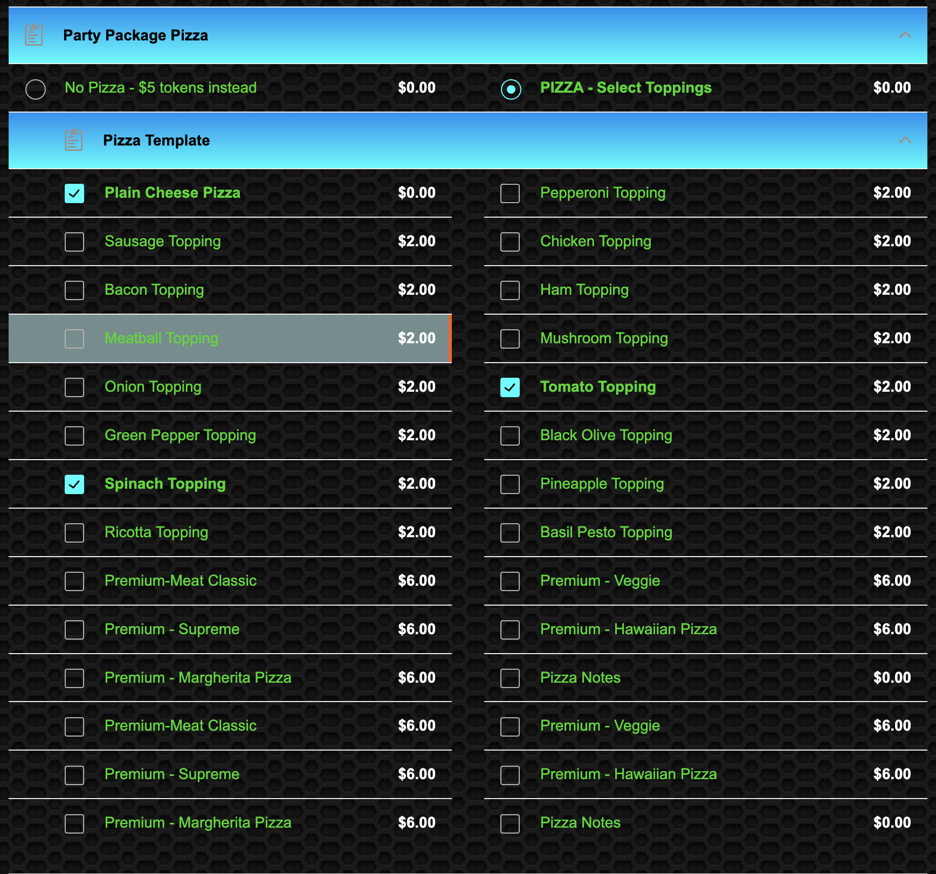

Slide 10
Decentralized Storage (Web or Mobile)
Project Goal
Create a 2 sided marketplace where owners will be able to register their driveways, garages, and empty rooms and have others users pay to store their items
Basically, this is AirBnb but for storage
Owners will be able to create as many listings as they want
Renters will be able to pay and reserve the spot
Key Features
Create profiles for owners and renters
Owners
Create and edit listings
View a dashboard of listings
Customers
Search listings
Rent listings
View rent history
Message owners and ask them questions
Accept customer payments
Allow businesses to withdraw funds

Slide 11
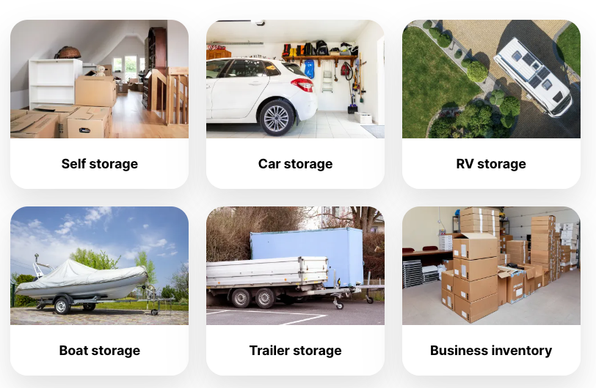
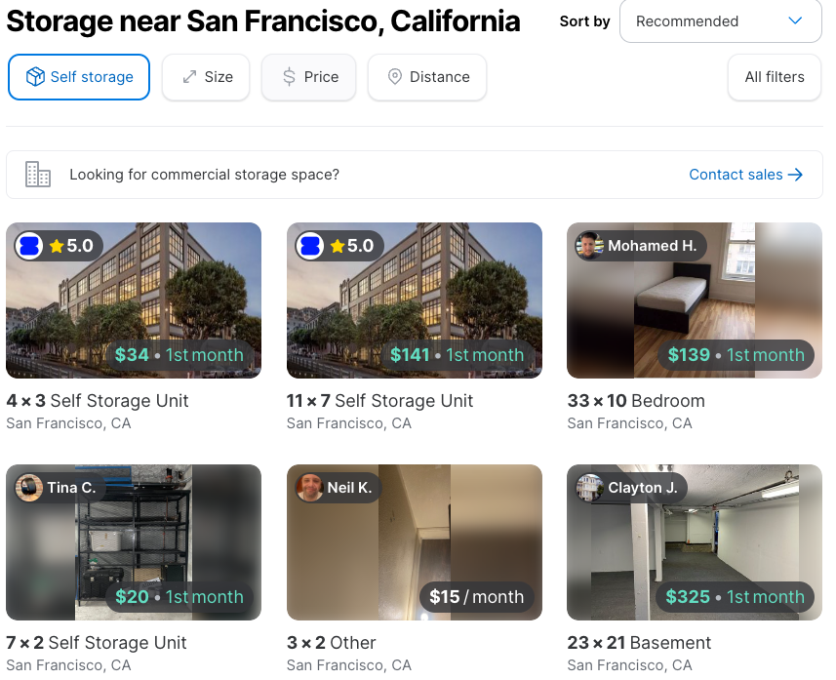
Decentralized Storage (Web or Mobile)

Slide 12
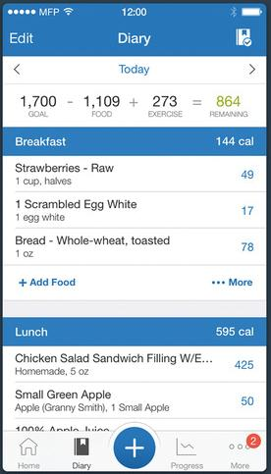
Food Tracker (Web or Mobile)
Project Goal
Allow users to track their weight and what they've eaten per day and view their progress
The MVP will be similar to MyFitnessPals Diary and Progress features
Users will be able to select from a predefined list of items or they can add their own
Users should be able to view their calories/macros/vitamins per day
Give recommendations for goals
Key Features:
Account creation
Track Food + Supplements (extra scan barcode)
Create meal plans to follow which can be modified

Slide 13
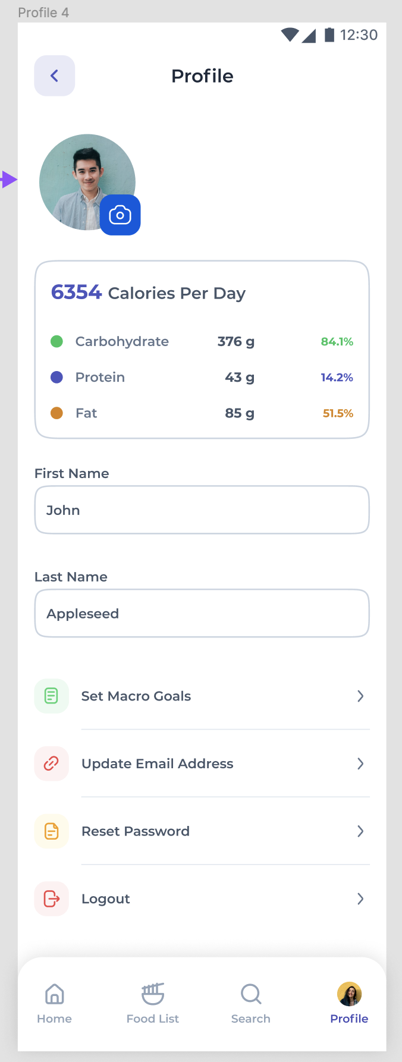
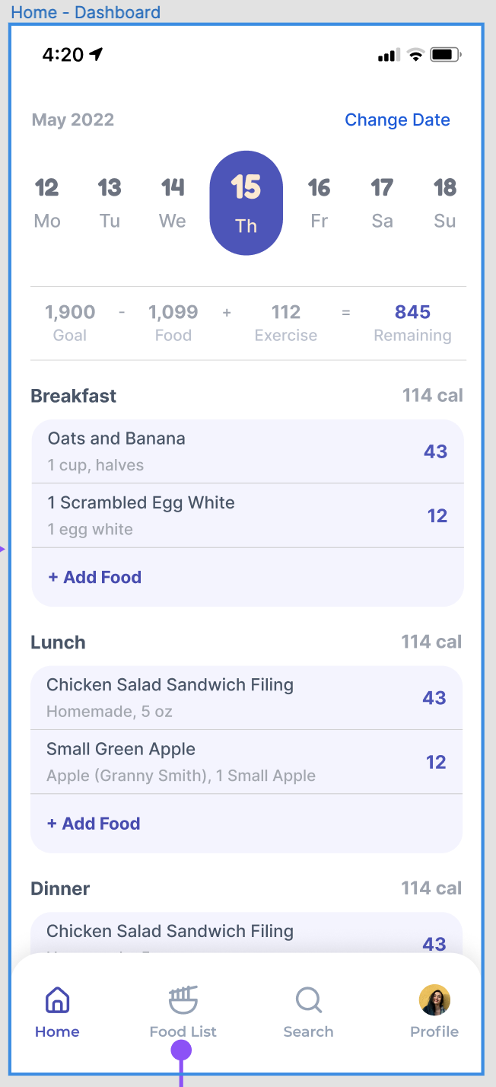
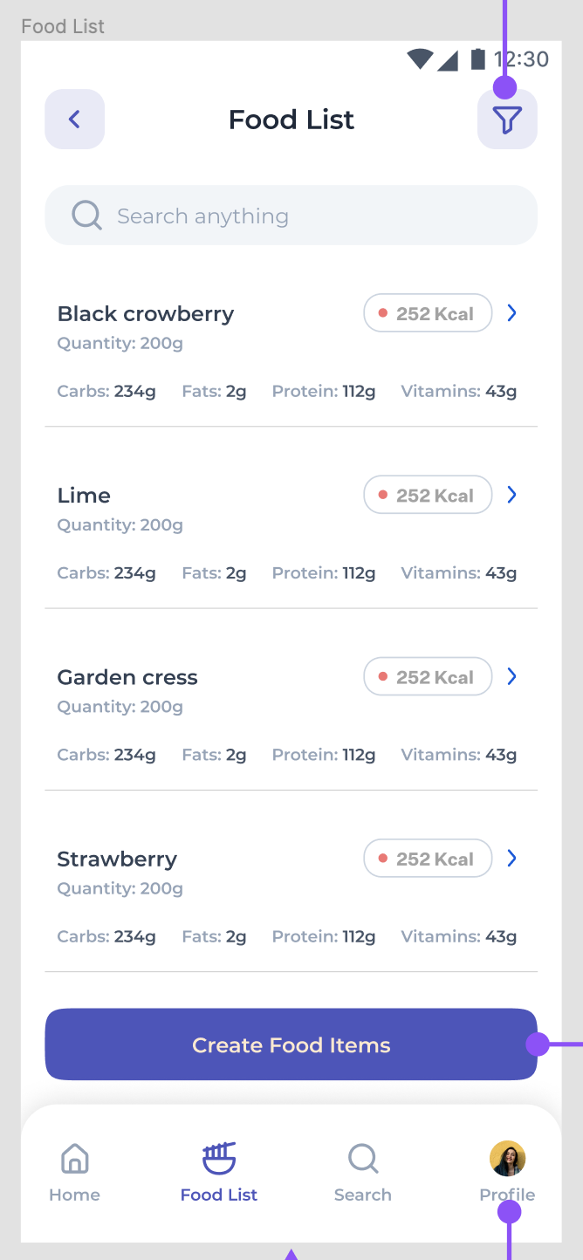
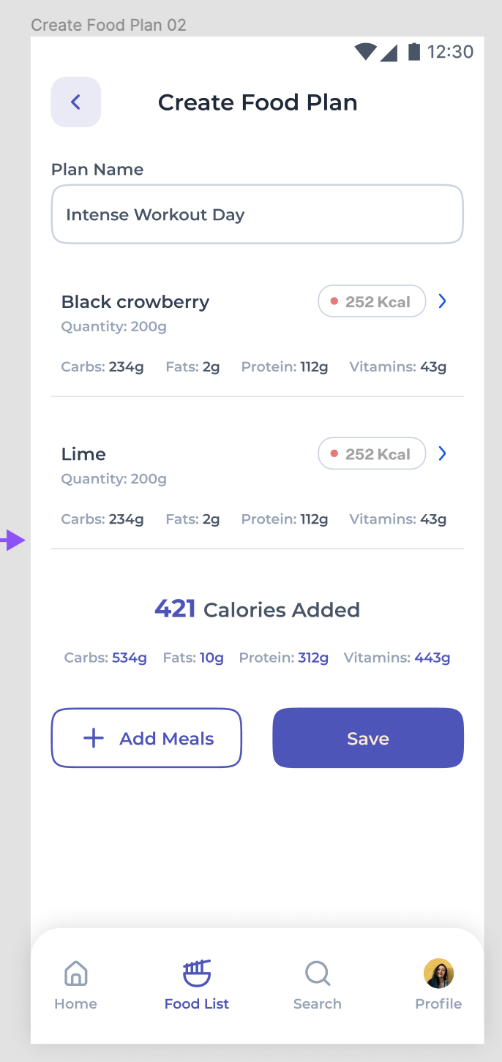
Food Tracker (Web or Mobile)

Slide 14
Food Ordering Platform (Web)
Key Features
Account creation + invitations
Anonymous addresses
Time zones
Define allergies / dislikes / diets
Coordinates purchases across different time zones
Purchase food
On demand
Credit
Influencer can accept the food or convert it into credit for them to purchase their own food
View purchase history
Project Goal
Allow users to be able to order and coordinate meals with other users across the US
Company events
Group of friends
Food influencers
MVP: we will start off with only being able to order pizza
Third party API integration is CRITICAL
https://developers.google.com/actions/food-ordering

Slide 15
Schedule/Goals
Preferred Tech
Week 1: Intro & Walkthrough
Tutorials
Access to GitHub
Week 2: Backend Tutorials: Node.js
Week 3: Frontend Tutorials: React.js or Swift
Week 4 - 12: Project Tasks
Bi-weekly tasks will be provided based on the number of students in each team and their experience
Weekly standups
Week 13-15:
Wrapping up key features
Poster presentations
Working on extra features if your team is ahead of schedule
Mobile Developer
Swift or Kotlin
React Native or Flutter
Front End Developer
React or Vue
Material-UI, Ant Design
Backend End Developer
AWS
Node.js with Express
Postgres Database
Jamstack SAAS (Advanced)
Chakra UI
Next.js
NestJS
Prisma (Node.js and TypeScript ORM)
NextAuth.js (Authentication for Next.js)
Tailwind CSS

Slide 16
Why should you pick one of my projects?
You will learn enough to apply for a junior software engineering position
Mobile Software Engineer
National Avg. Salary: $127,000
Node.js (API) Software Engineer
National Avg. Salary: $110,000
React.js (Web) Software Engineer
National Avg. Salary: $120,000
Real world experience
Opportunity to give feedback on the product and roadmap
Sprint workshops
Resume Review
LinkedIn Recommendation
Technical Interview Problems + Mock Interviews
No prior experience needed
You will learn the fundamentals as you go
Must have a desire to learn
1-1 help to debug your code
Mentorship beyond USF
Grad School Recommendations
Job references
Resources
Tutorials & courses
Resume
LinkedIn
Connect with Alumni students through our Slack channel
Job Referrals
Public recognition when we launch!

Slide 17
Questions?
Feel free to reach out!
Jose Alvarado <josealvarado111@gmail.com>
Projects: https://www.sfdevshop.com/2022-fall-undergrad.html
LinkedIn: https://www.linkedin.com/in/josealvarado111/
LinkTree: https://linktr.ee/imjosealvarado

