Slide 1
Projects for USF CS Students 2023
By Jose Alvarado

Slide 2
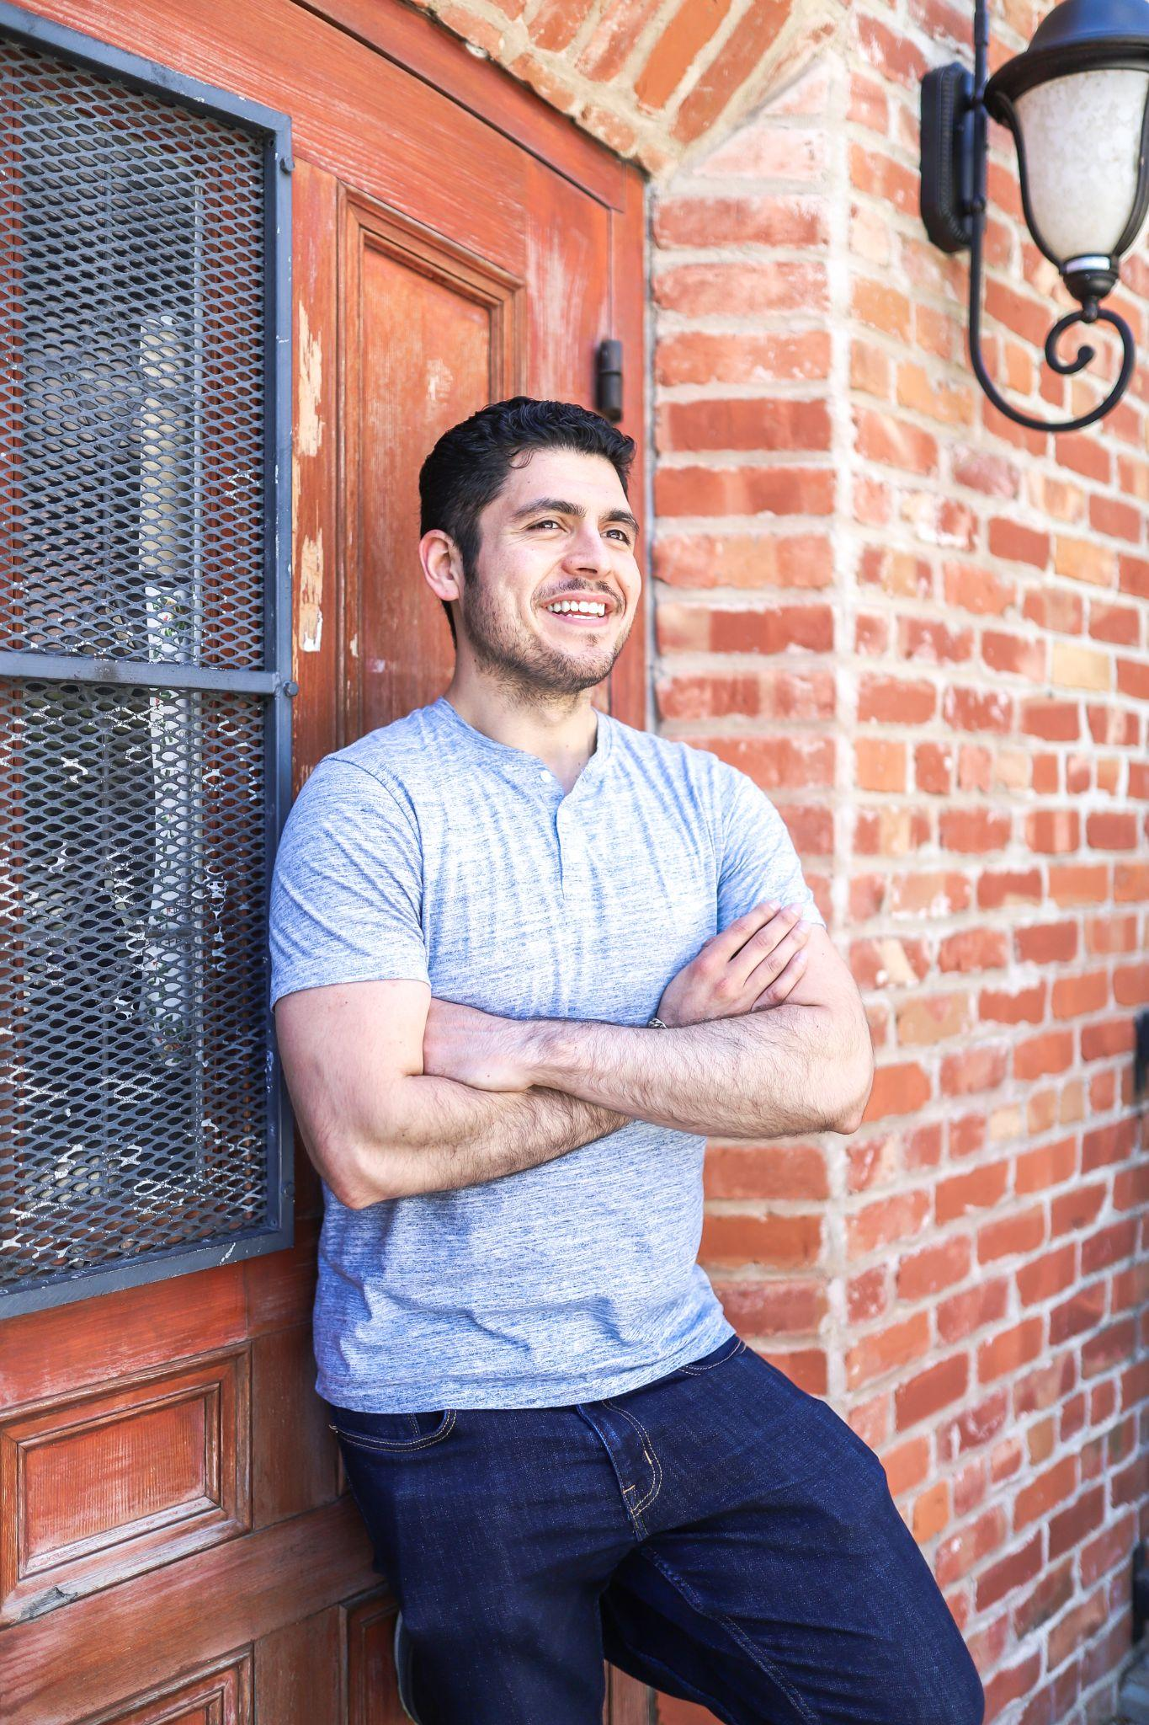
Introduction
Business Owner
iOS Software Engineer
Sold Battle Blast Laser Tag in Nov 2022 for $500K
Engineering Manager where I managed the mobile, web, and platform teams
Founded 3 startups
2 successful exists
Founded SF Dev Shop
Freelance projects on the side for other companies
Jose Alvarado
2015: M.S. in Computer Science from USF

Slide 3
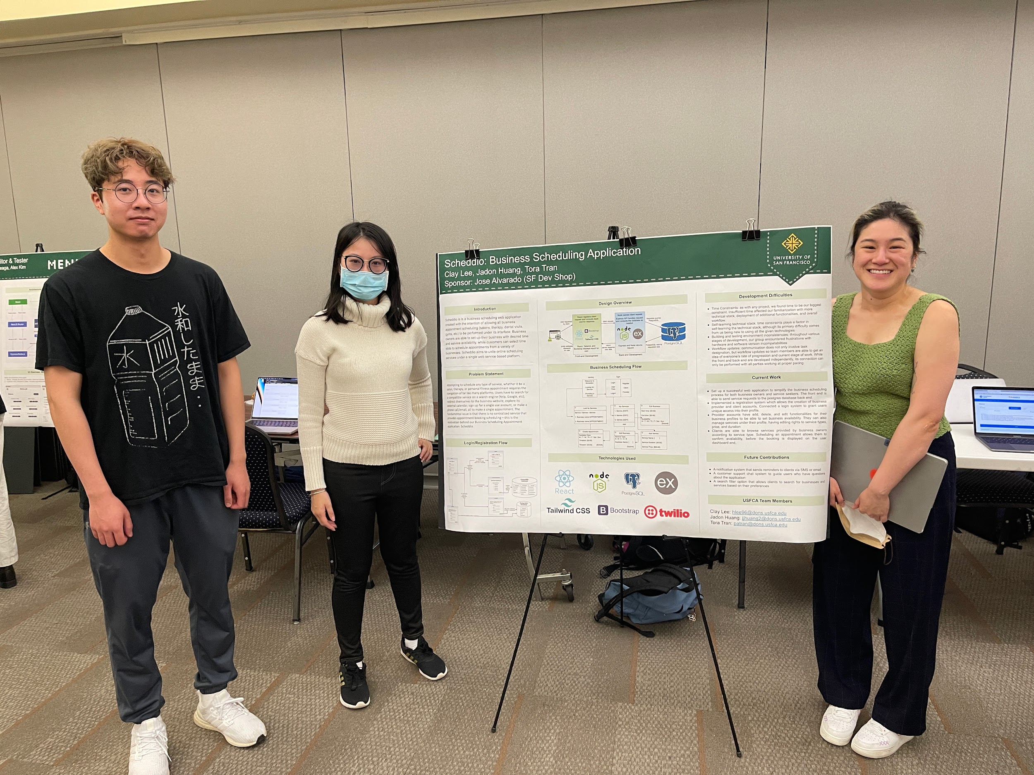
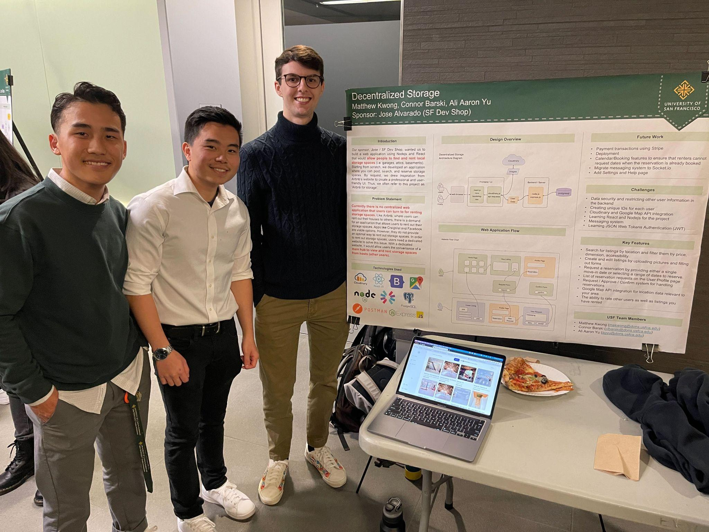
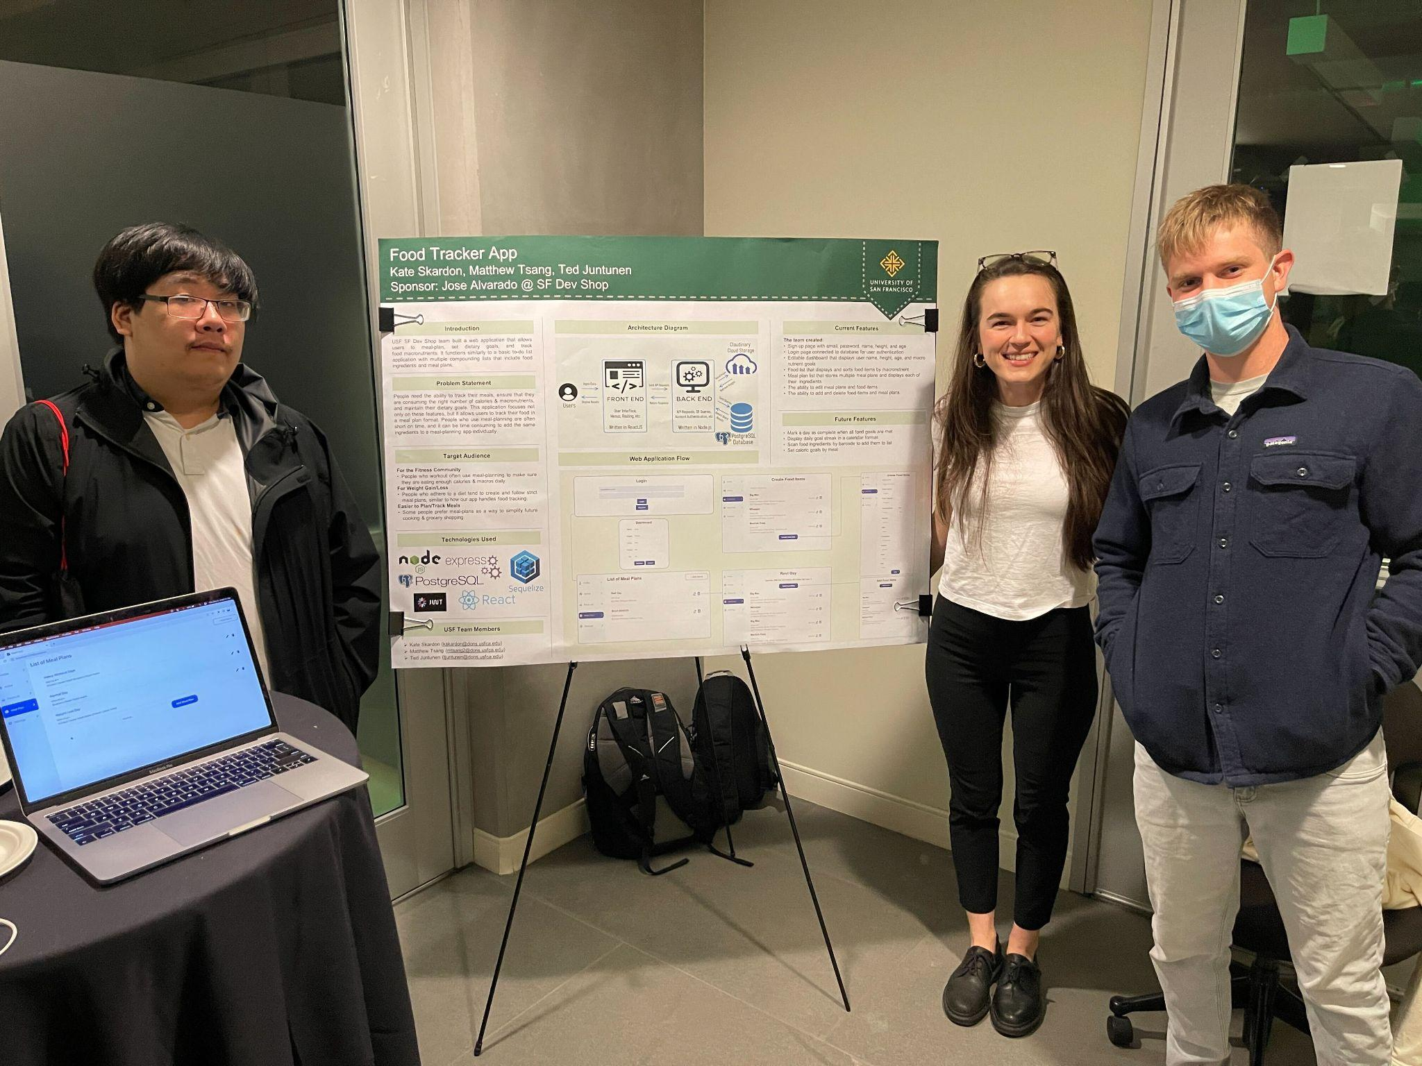
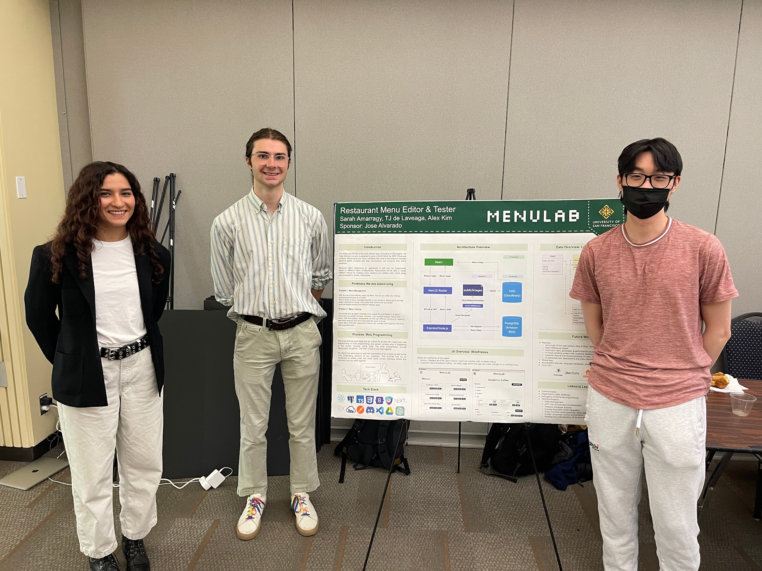
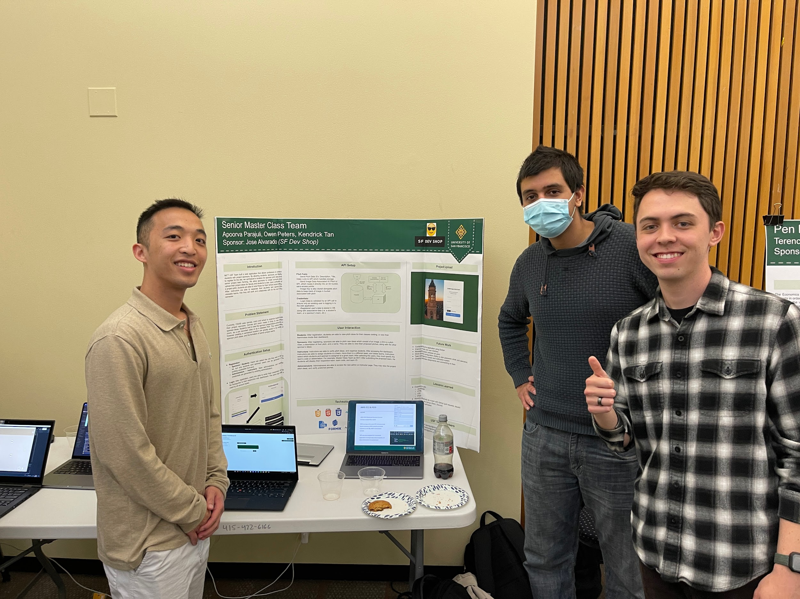
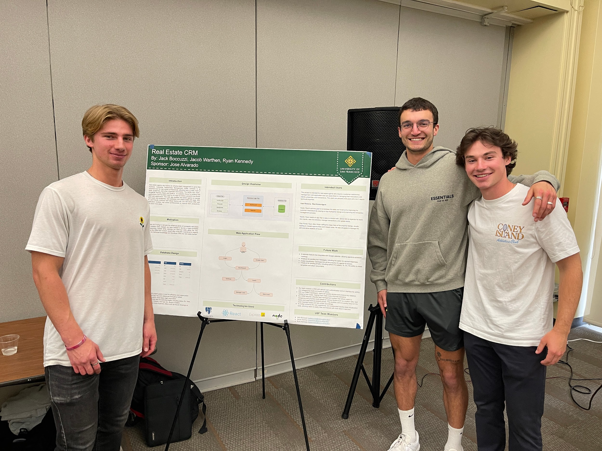
Student Stats
2017 - Present
Worked with 150 students
44 Projects

Slide 4
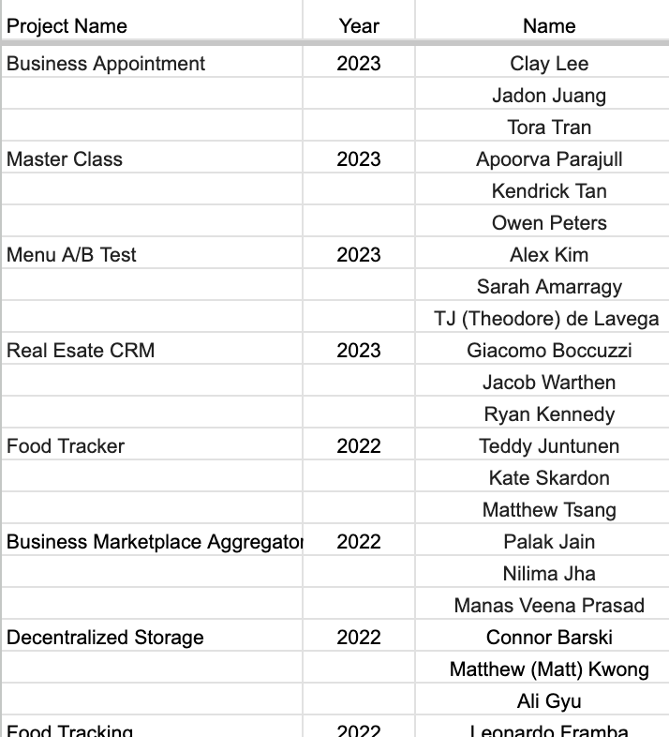
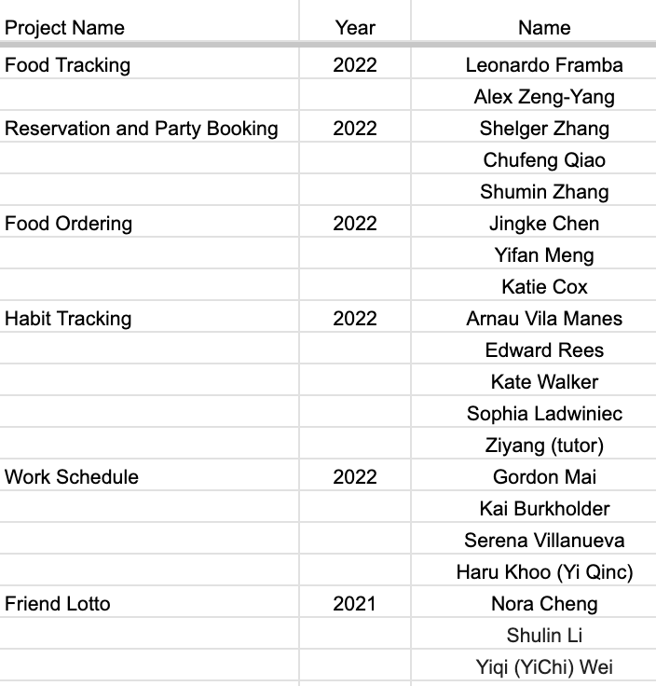
Students I worked with recently

Slide 5
Projects
App to rent out home gyms (Web or Mobile)
Personal Finance Management App (Web)
Influencer Marketing Platform (Website)

Slide 6
App to rent out home gyms (Web or Mobile)
Project Goal
Create an application that allows hosts to list their home gym and allow regular users to rent their gym
Similar to Airbnb but with gyms
Advanced Goal
Allow hosts to list specific gym equipment like bench press, squat rack, trap bar, etc. and allow renters to search by gym equipment
Maybe allow users to rent specific equipment
Key Features
Create profiles for hosts and renters
Hosts can list their gym
Search functionality
Messaging system
Booking system
Calendar integration
Payment and rating system
Notifications

Slide 7
Personal Finance Management App (Web)
Project Goal
Create a comprehensive personal finance solution that caters to both individuals and business
The app generates profit and loss statements and provides insights into spending habits, helping users optimize their financial decisions
Integrate with Plaid to pull transactions from bank accounts
Key Features
User registration
Income/Expense Tracking
Budgeting
Profit and Loss Statements
Transaction Categorization
Saving Goals

Slide 8
Influencer Marketing Platform (Website)
Project Goal
Create a platform that facilitates seamless collaboration between brands and influencers for effective marketing campaigns
Students will work in teams to design, develop, and launch an influencer marketing platform that connects businesses with relevant influencers, streamlining campaign management and maximizing marketing impact
Key Features
User authentication and profiles
Influencer discovery
Campaign creation
Messaging system
Content collaboration
Performance analytics
Payment and compensation
Social media integration
Dashboard and notifications

Slide 9
Schedule/Goals
Preferred Tech
Week 1: Intro & Walkthrough
Tutorials
Access to GitHub
Week 2: Backend Tutorials: Node.js
Week 3: Frontend Tutorials: React.js or Swift
Week 4 - 12: Project Tasks
Bi-weekly tasks will be provided based on the number of students in each team and their experience
Weekly standups
Week 13-15:
Wrapping up key features
Poster presentations
Working on extra features if your team is ahead of schedule
Mobile Developer
Swift or Kotlin
React Native or Flutter
Front End Developer
React or Vue
Material-UI, Ant Design
Backend End Developer
AWS
Node.js with Express
Postgres Database
Jamstack SAAS (Advanced)
Chakra UI
Next.js
NestJS
Prisma (Node.js and TypeScript ORM)
NextAuth.js (Authentication for Next.js)
Tailwind CSS

Slide 10
Why should you pick one of my projects?
You will learn enough to apply for a junior software engineering position
Mobile Software Engineer
National Avg. Salary: $127,000
Node.js (API) Software Engineer
National Avg. Salary: $110,000
React.js (Web) Software Engineer
National Avg. Salary: $120,000
Real world experience
Opportunity to give feedback on the product and roadmap
Sprint workshops
Resume Review
LinkedIn Recommendation
Technical Interview Problems + Mock Interviews
No prior experience needed
You will learn the fundamentals as you go
Must have a desire to learn
1-1 help to debug your code
Mentorship beyond USF
Grad School Recommendations
Job references
Resources
Tutorials & courses
Resume
LinkedIn
Connect with Alumni students through our Slack channel
Job Referrals
Public recognition when we launch!

Slide 11
Questions?
Feel free to reach out!
Jose Alvarado <josealvarado111@gmail.com>
Projects: https://www.sfdevshop.com/2023-spring.html
LinkedIn: https://www.linkedin.com/in/josealvarado111/
LinkTree: https://linktr.ee/imjosealvarado

