Slide 1
Projects for USF CS Students 2023
By Jose Alvarado

Slide 2
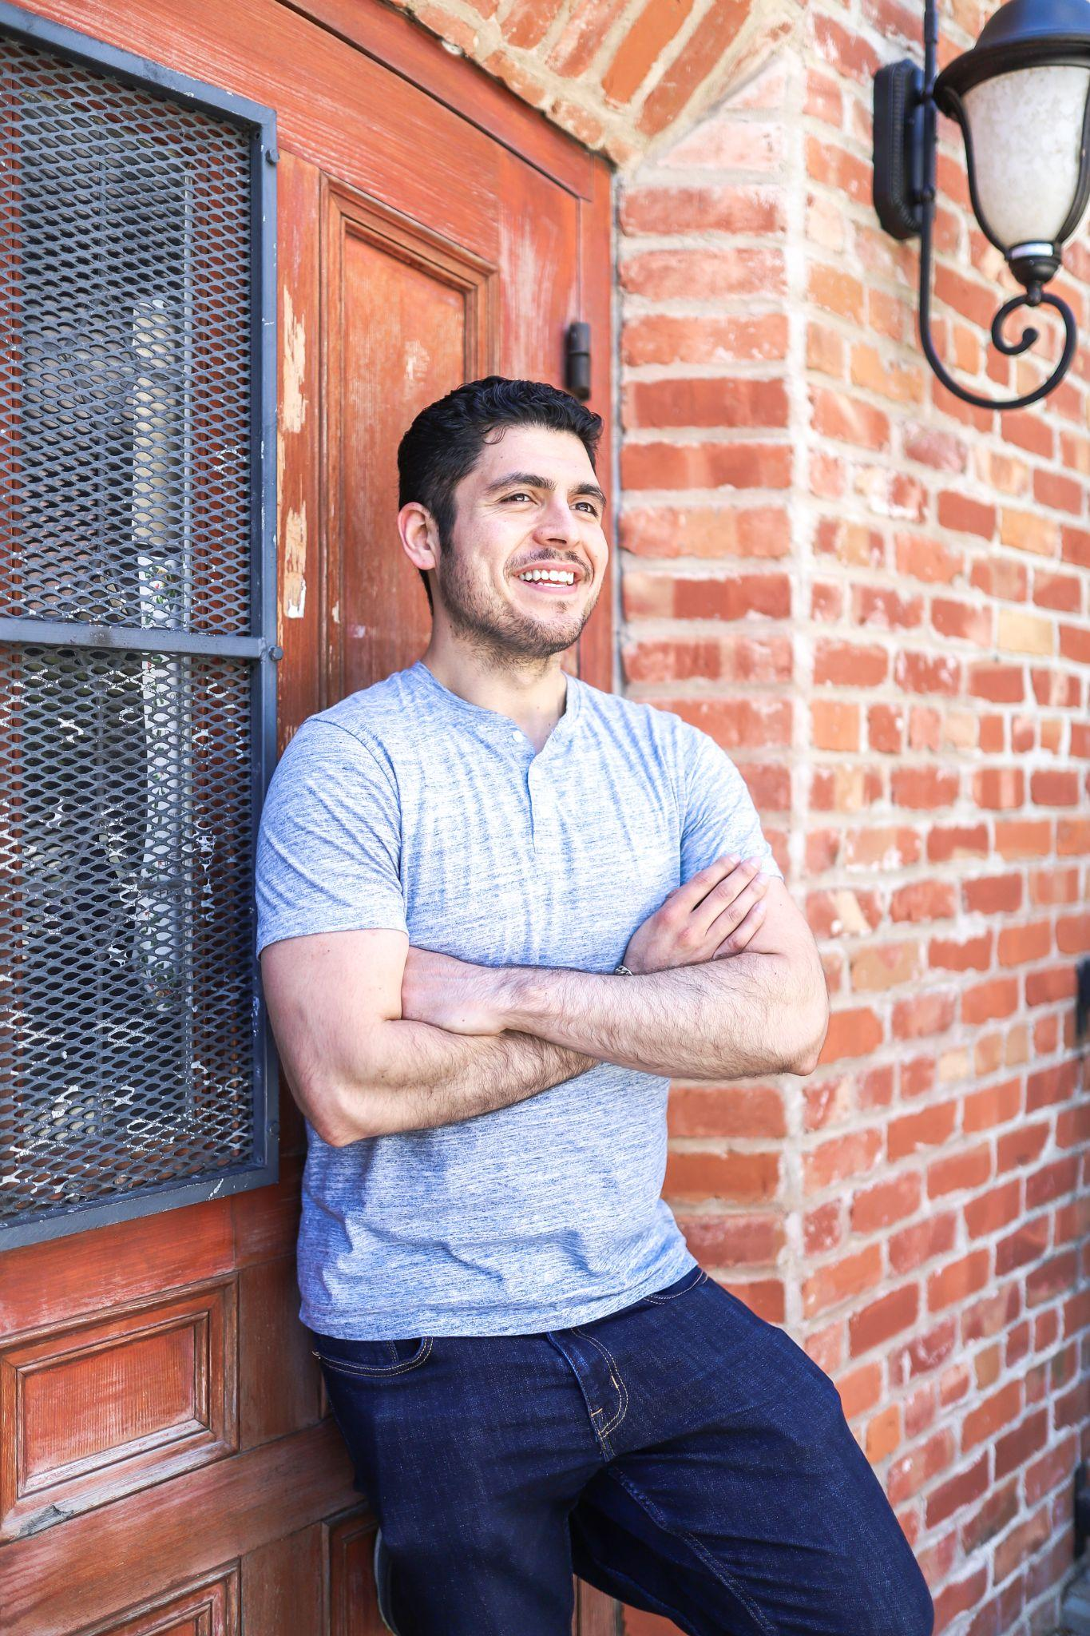
Introduction
Business Owner
iOS Software Engineer
Sold Battle Blast Laser Tag in Nov 2022 for $500K
Engineering Manager where I managed the mobile, web, and platform teams
Founded 3 startups
2 successful exists
Founded SF Dev Shop
Freelance projects on the side for other companies
Jose Alvarado
2015: M.S. in Computer Science from USF

Slide 3
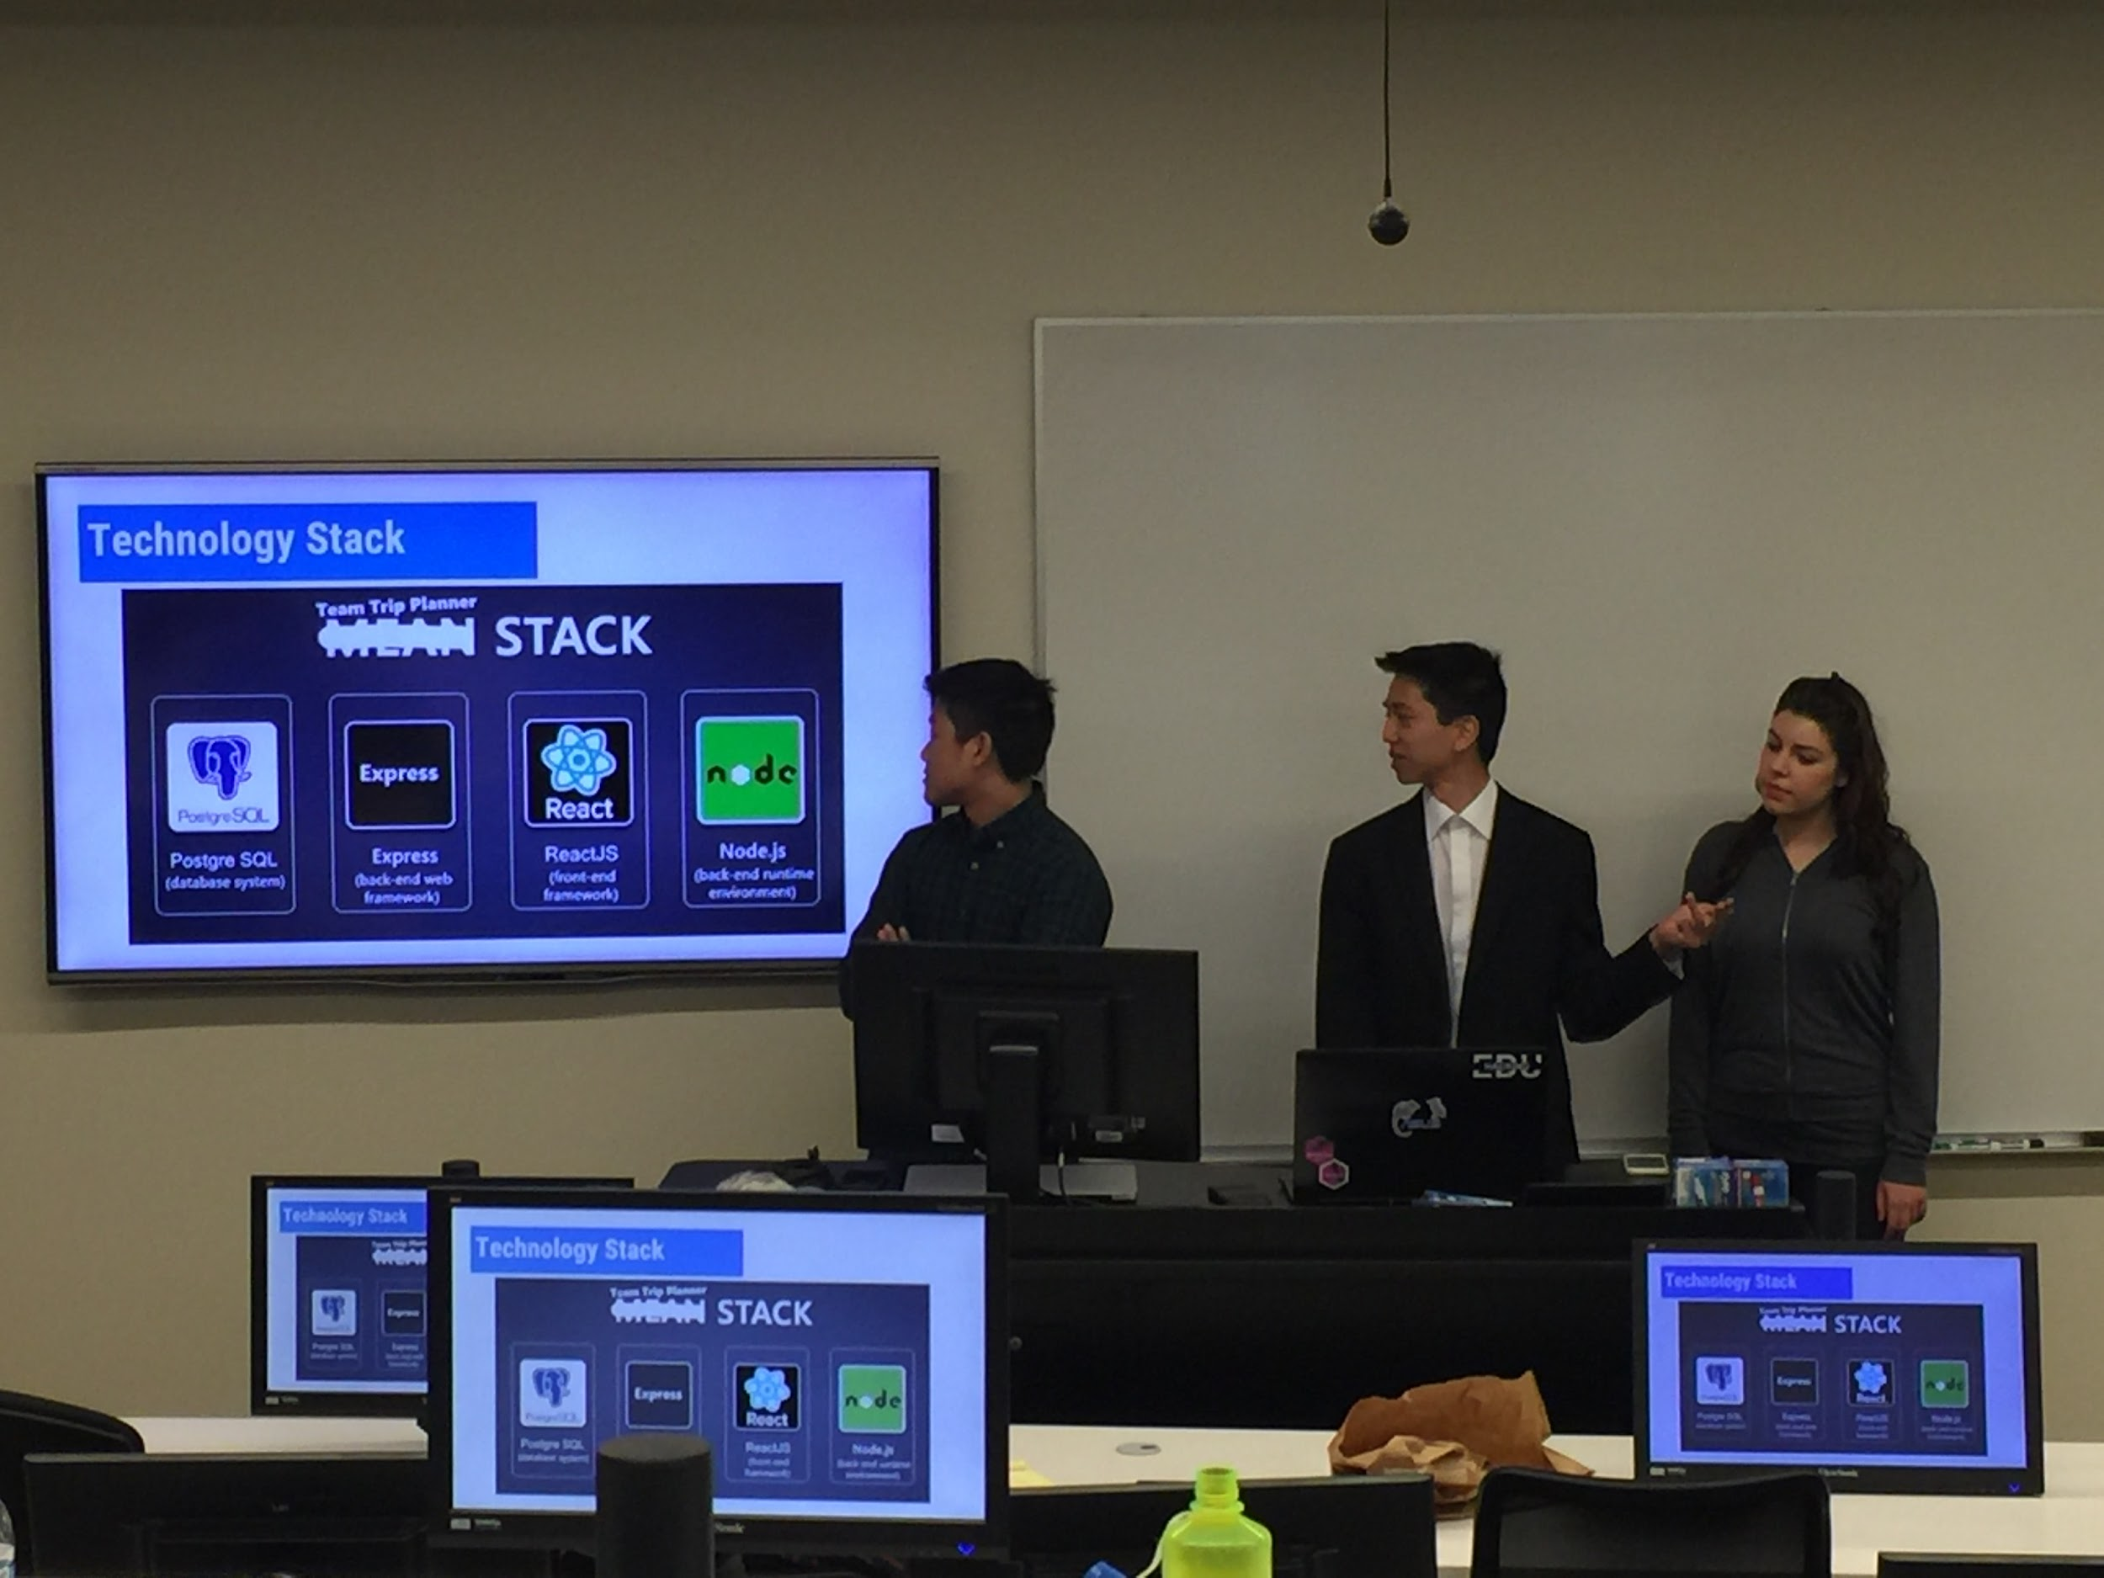
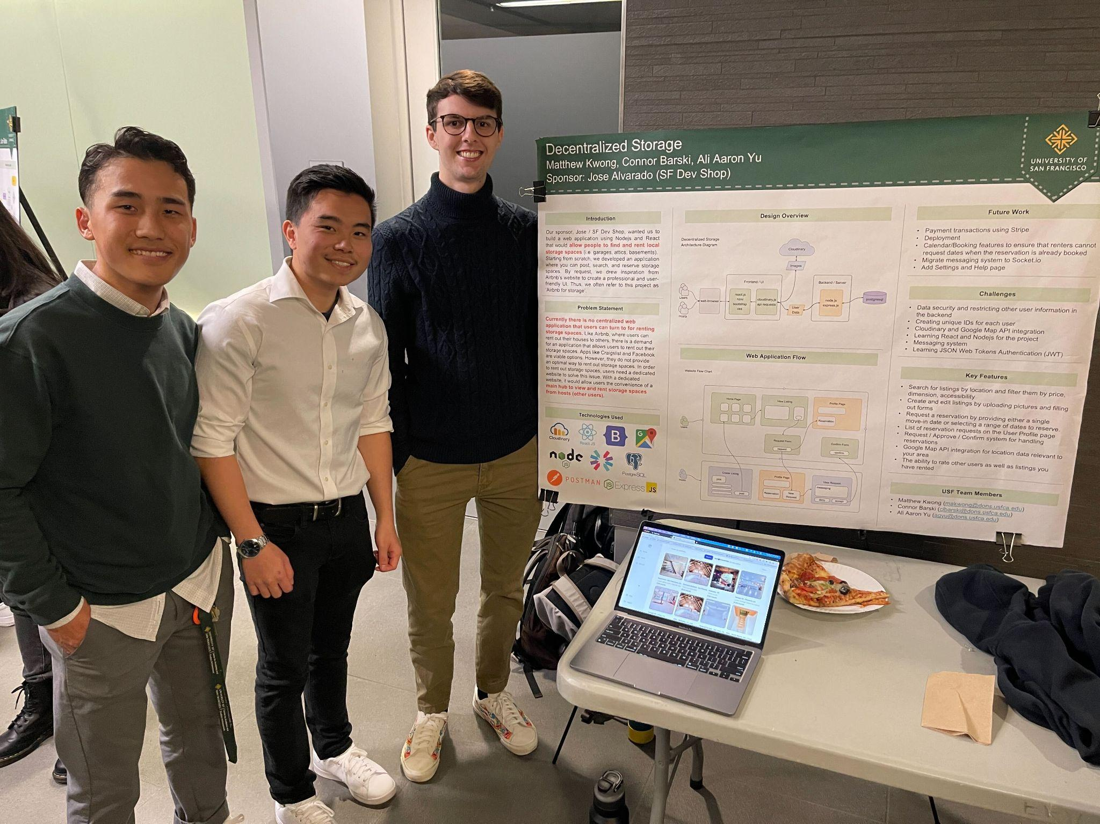
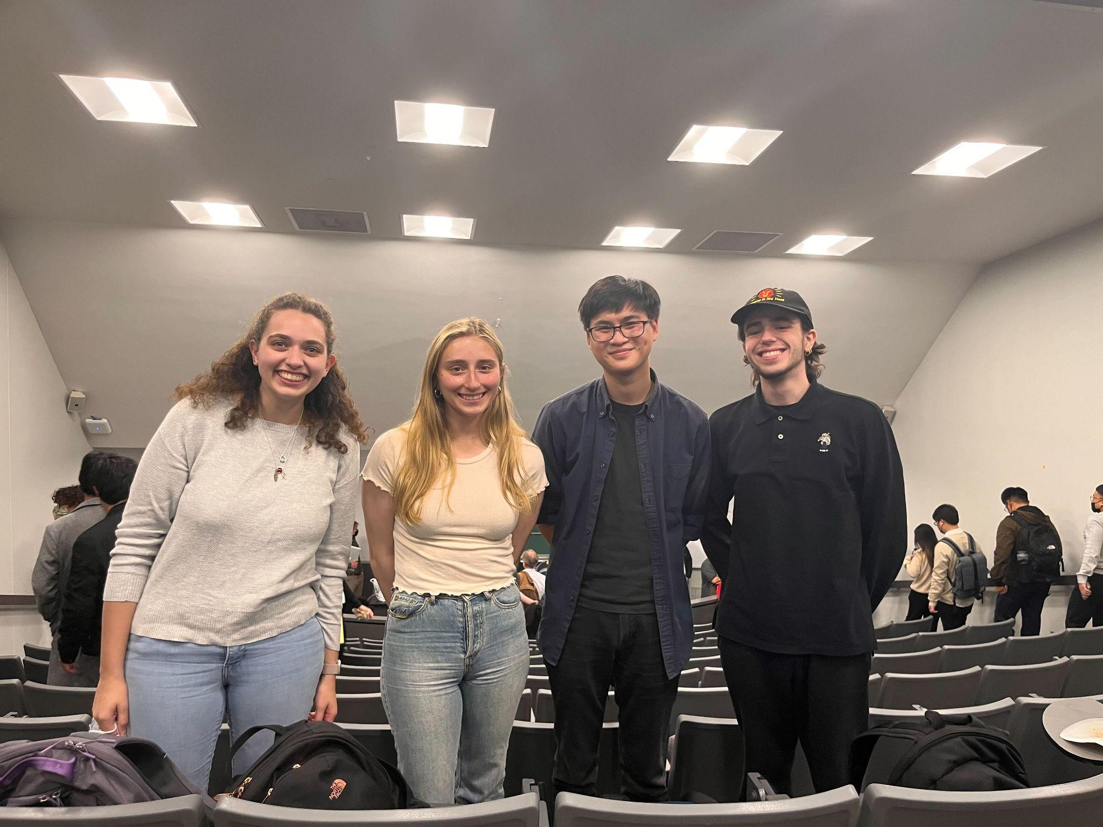
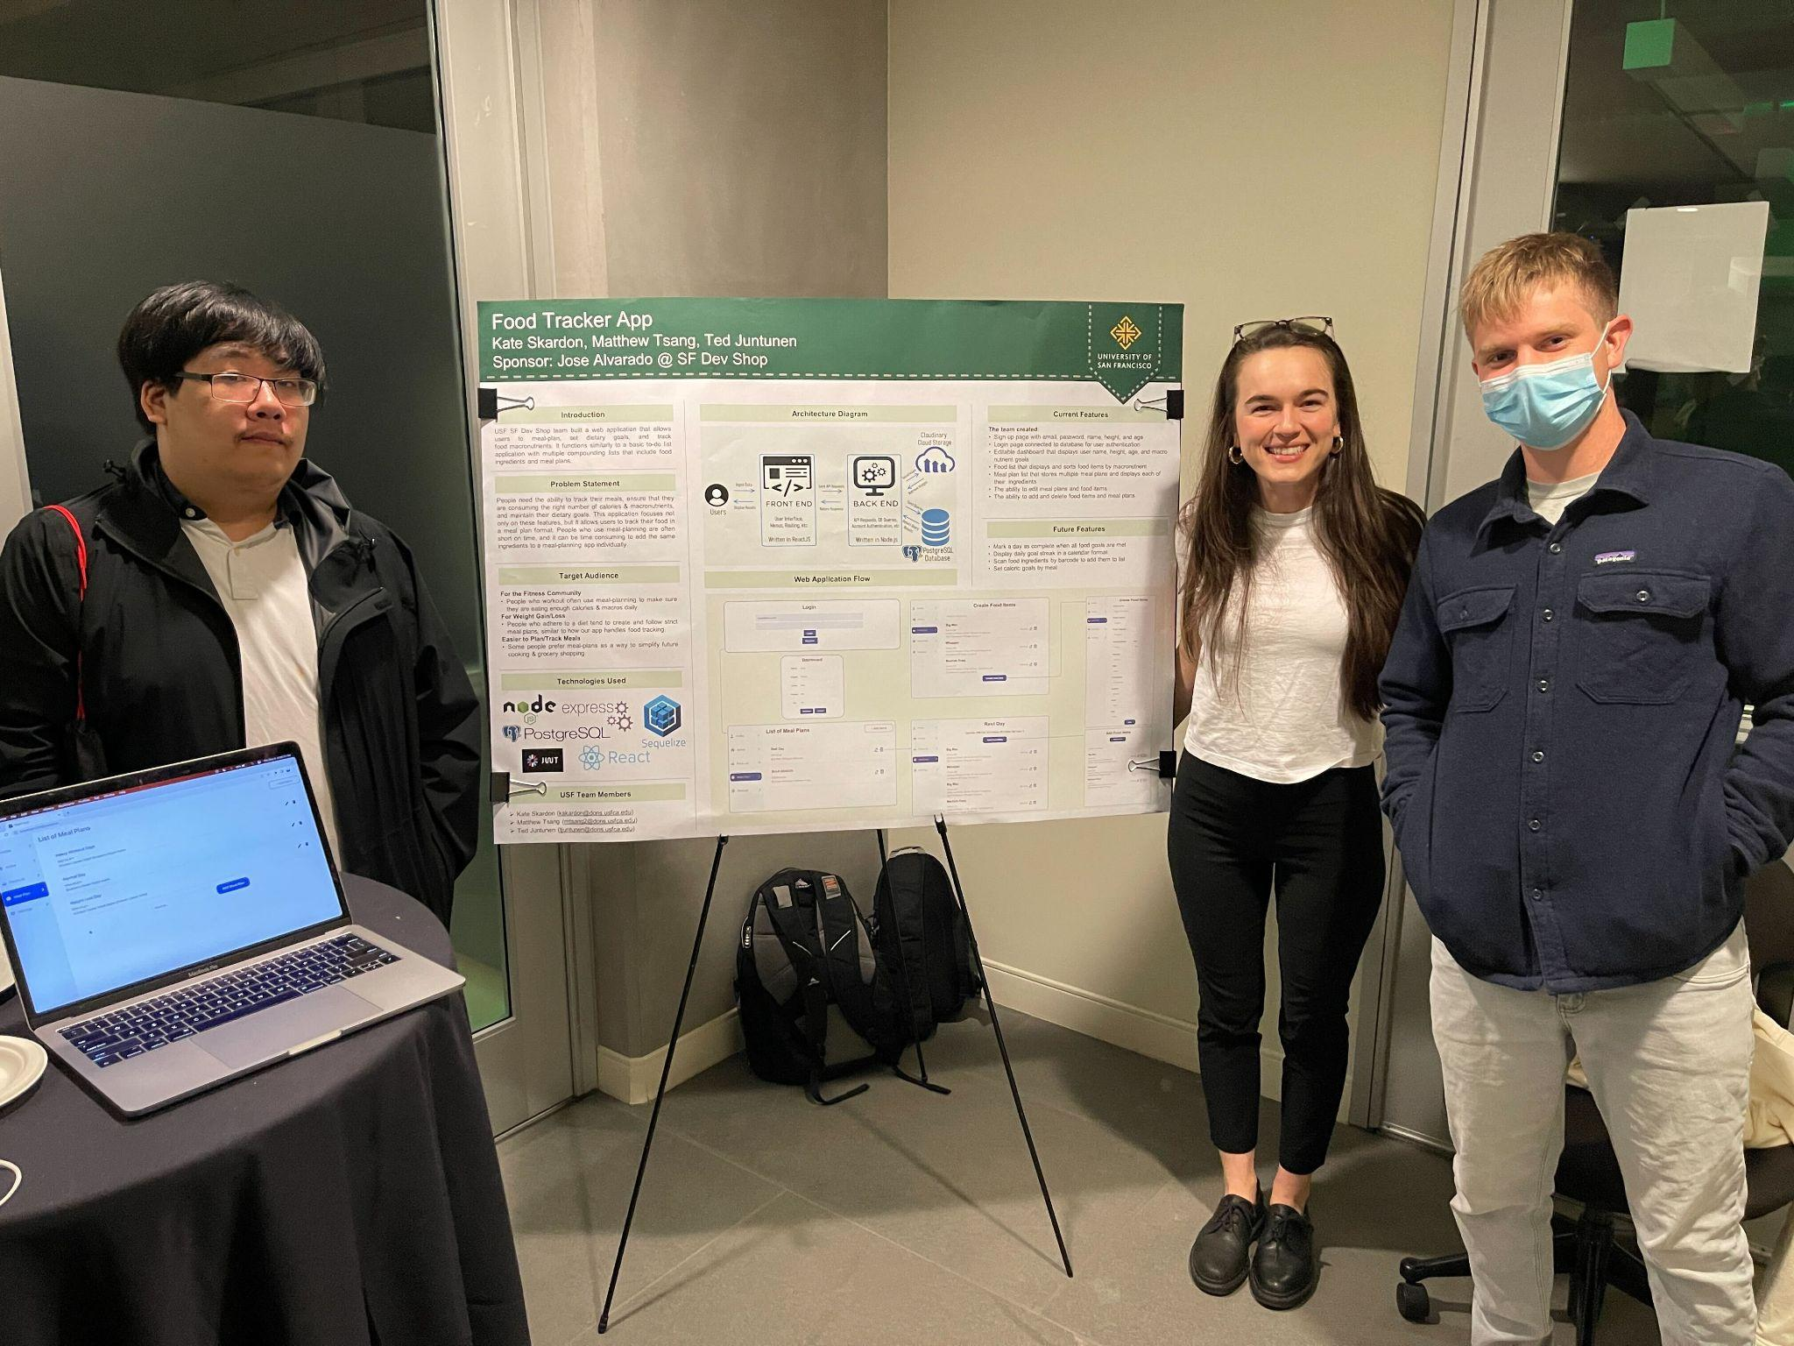
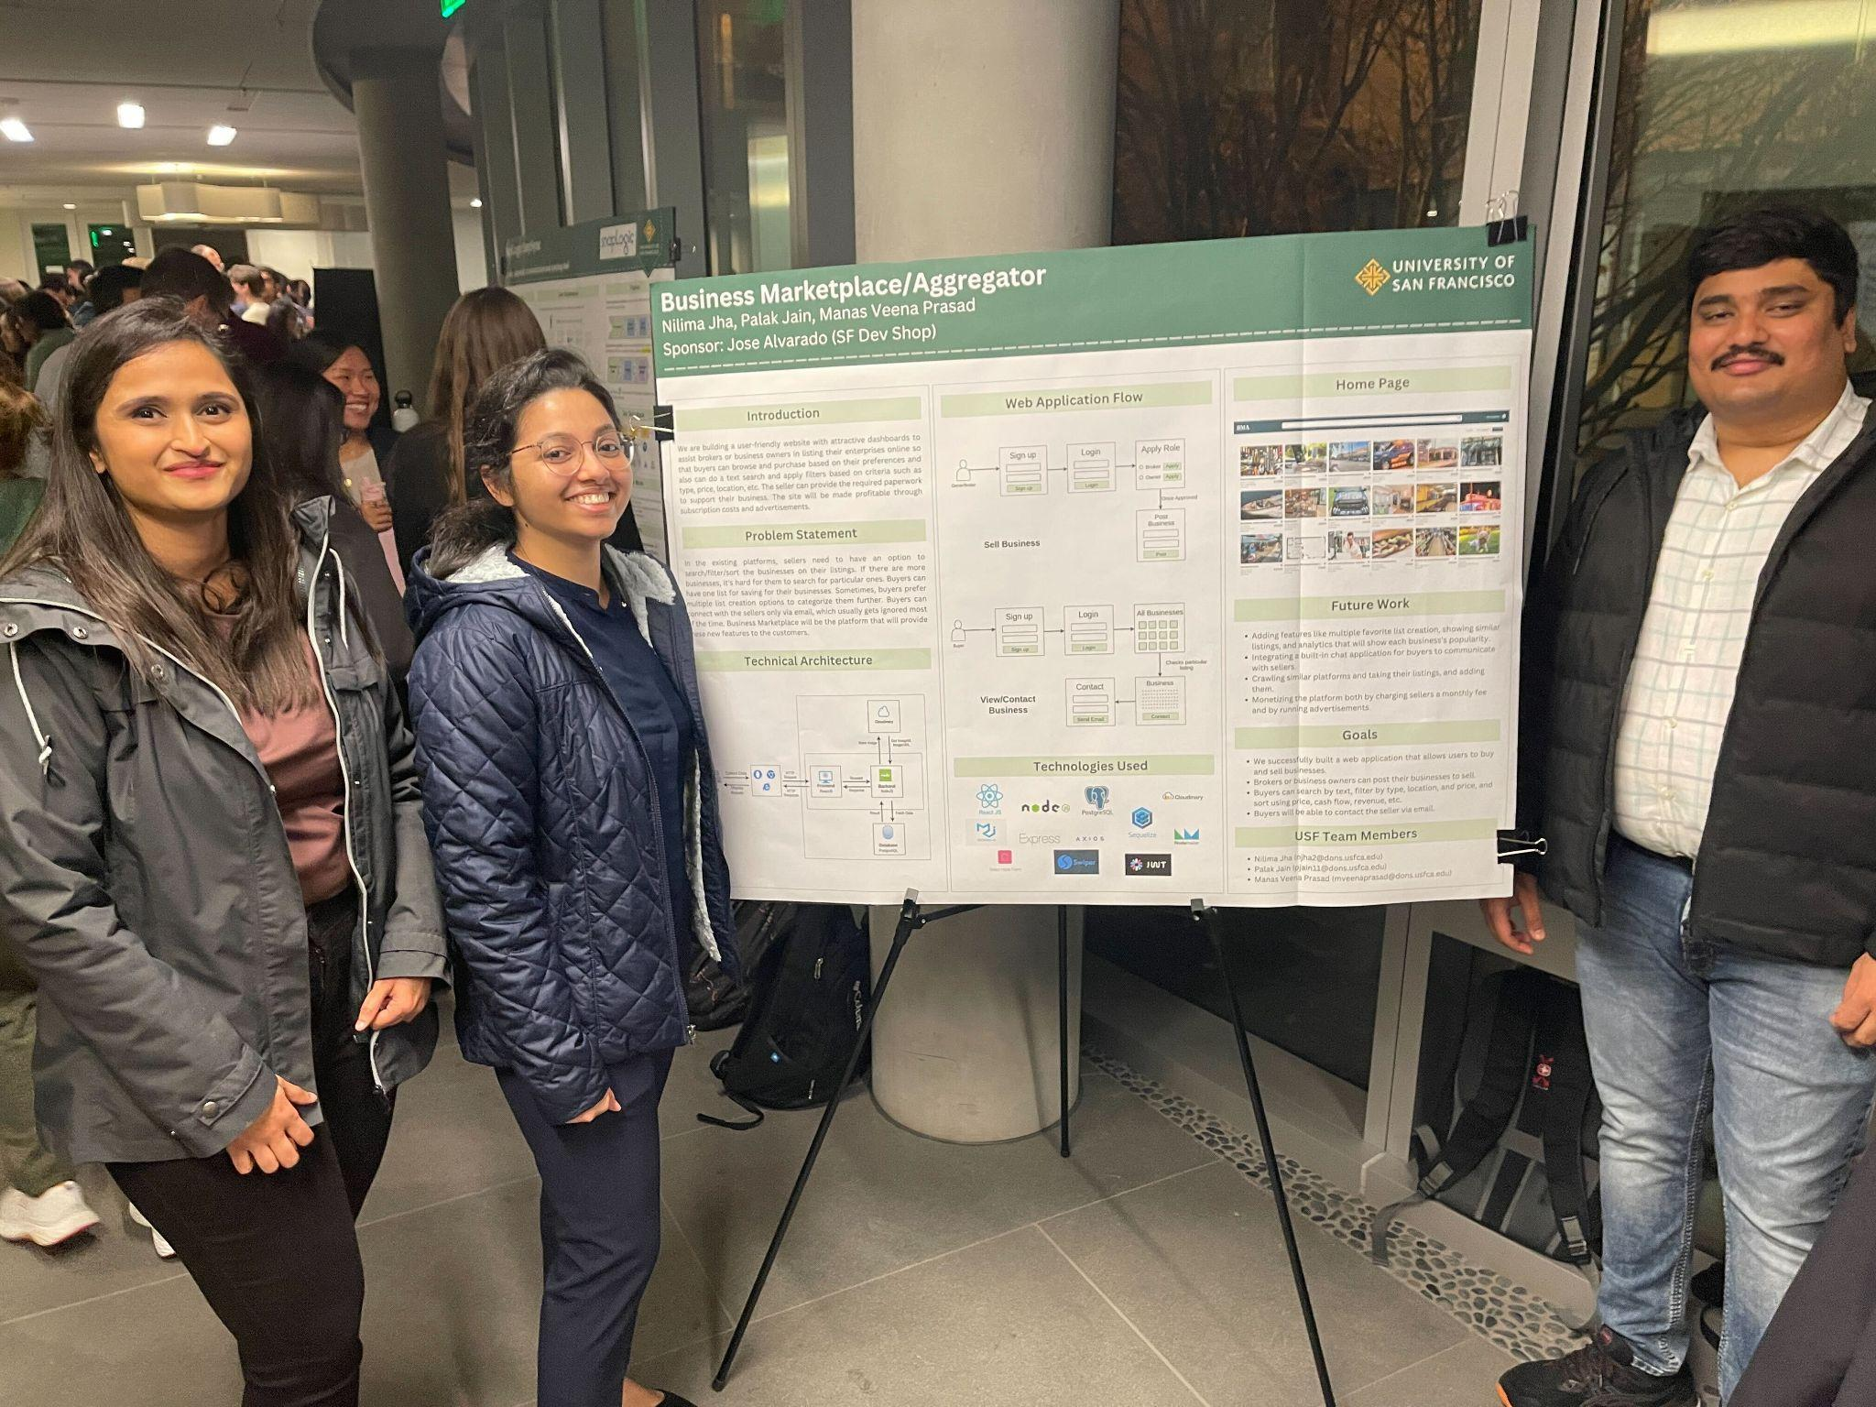
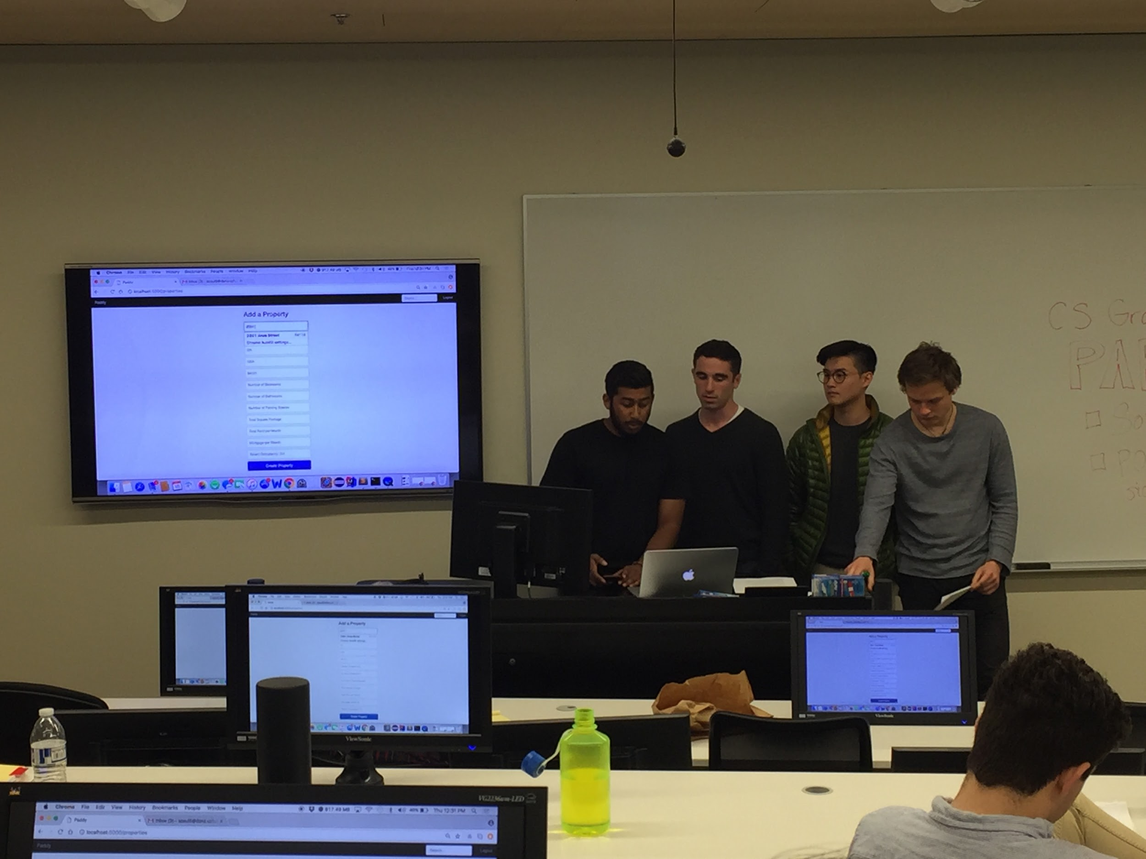
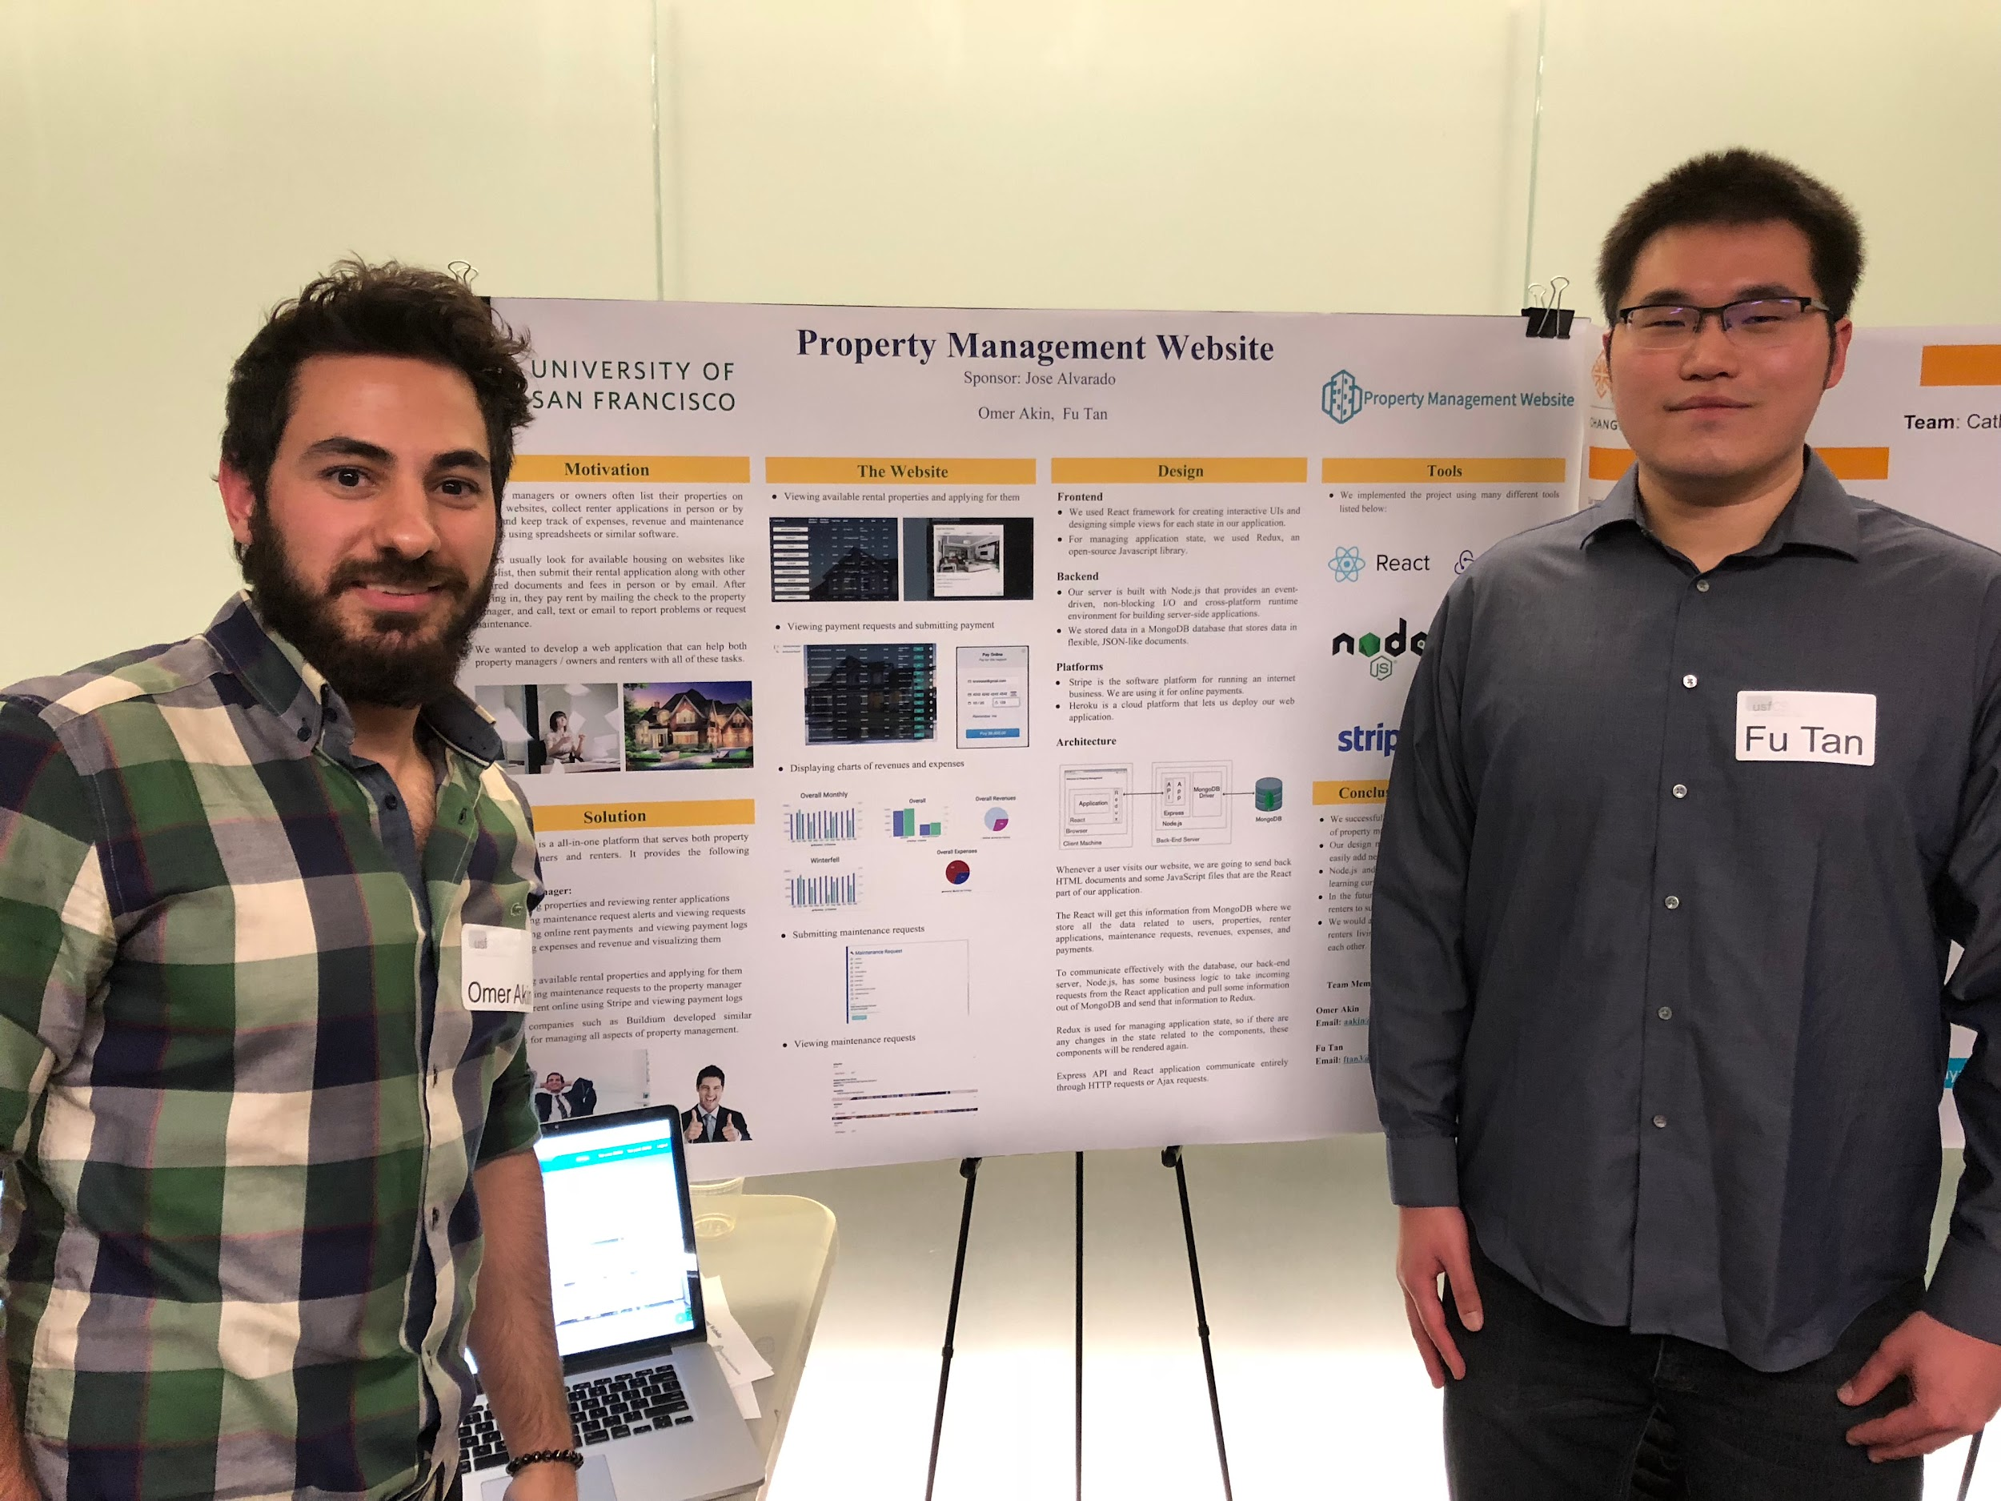
Student Stats
Feb 2017 - Present
Worked with 139 students
40 Projects

Slide 4
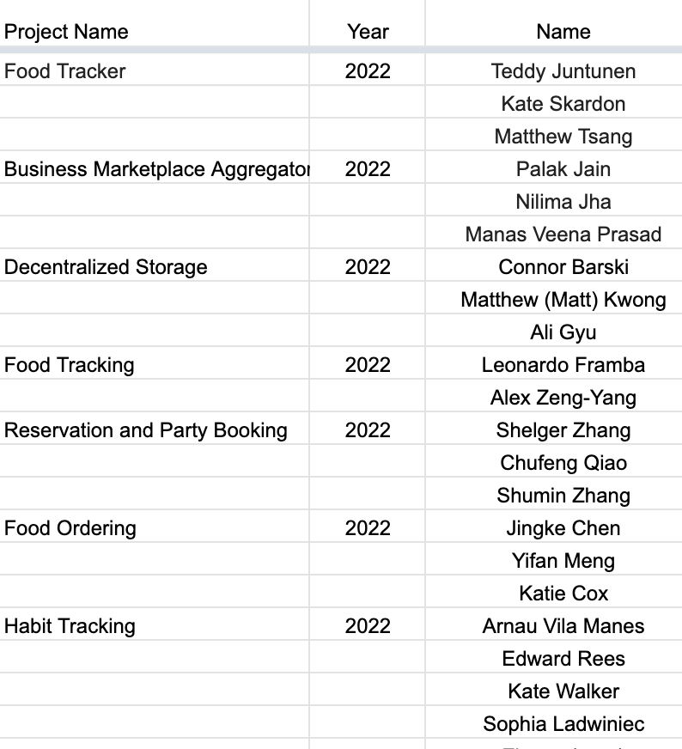
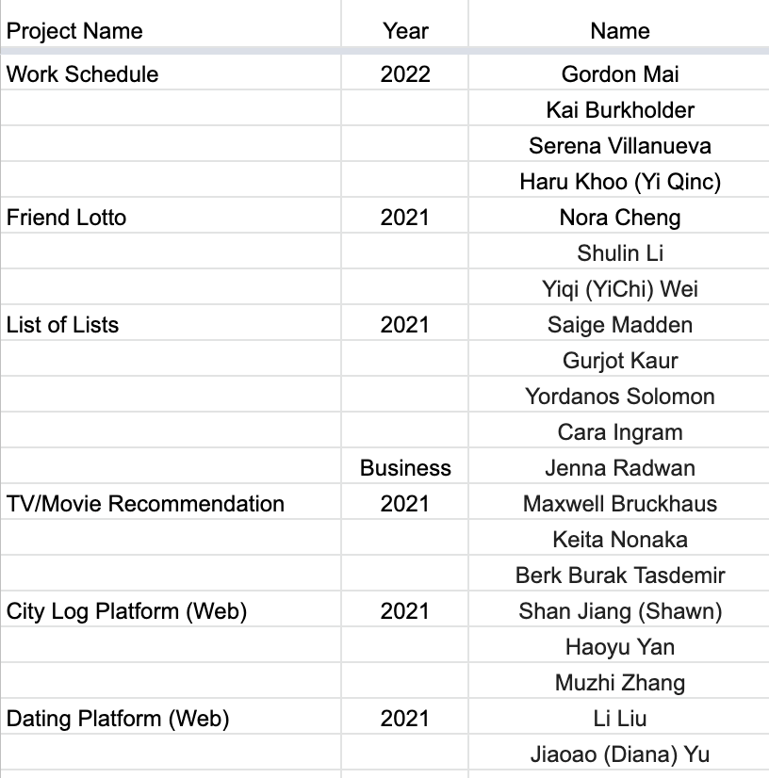
Students I worked with recently

Slide 5
Projects
CRM for real estate agents
App to rent out home gyms
CS Senior Master Class
App to track the process/stage of a service based business
App to find salons, dentist, spas, etc and make appointments
App to A/B test restaurant menus

Slide 6
CRM for real estate agents (Web)
Project Goal
Create a CRM (Customer Relationship Management Platform) that is easy to use and affordable
Advanced Goal
Create profiles for companies to manage multiple agents and have an administrative portal that allows them to view activity and statistics across their whole company
Key Features
Create profiles for agents
Manage a list of contacts
Contact info
Add notes
Classify type of lead
Schedule calendar appointments
Include address
Send emails to clients
Monthly subscription

Slide 7
App to rent out home gyms (Web or Mobile)
Project Goal
Create an application that allows hosts to list their home gym and allow regular users to rent their gym
Similar to Airbnb but with gyms
Advanced Goal
Allow hosts to list specific gym equipment like bench press, squat rack, trap bar, etc. and allow renters to search by gym equipment
Maybe allow users to rent specific equipment
Key Features
Create profiles for hosts and renters
Hosts can list their gym
Search functionality
Messaging system
Booking system
Calendar integration
Payment and rating system
Notifications

Slide 8
CS Senior Master Class (Website)
Project Goal
Create an application that allows professors to connect students with project sponsors
Advanced Goal
Allow sponsors to create accounts and upload projects
Professors can then search different projects and invite sponsors with great projects to their class
Create university profiles and list professors, their classes, and the projects classrooms have successfully completed
Key Features
Create profiles for professors, students, and sponsors
Create classrooms
Invite students and sponsors
Edit class information
Add assignments and tasks
View list of projects
Messaging system
Calendar and notification system
Define when sponsors and students meet
Grading and feedback system

Slide 9
App to track the process/stage of a service based business (Web or Mobile)
Project Goal
Create an application that allows service based business to update the status of their work to their clients
For example
A mechanic inspecting a vehicle
Waitlist
Inspection In Progress
Reporting
Property surveyors
On the way
Onsite
Inspecting water lines
Completed
Key Features
Create profiles for companies and employees
System for creating and managing service orders
System that allows employees to track the progress of a task within the service order
Notification system
Customer communication system
Reporting system that allows business to see metrics
Completed orders
Avg turnaround time
Rating system

Slide 10
App to find business and make appointments (Web or Mobile)
Project Goal
Create an application that allows businesses to list their company and allows customers to book an appointment
For example
Beauty salons
Dentists
Spas
Advanced Goal
Allow customers to book appointments directly with an employee
For example
Barbershops
Key Features
Create profiles for companies and customers
Booking system
Messaging system
Payment system
Rating system
Notification system
Admin panel that allows businesses to manage reservations, approve bookings, and update availability

Slide 11
A/B test restaurant menus (Web or Mobile)
Project Goal
Create an application that allows businesses to list their menu and customers to make orders
Customers will also be able to keep track of what they ate
Key Features
Create profiles for restaurants and customers
A system for creating and managing menu items
A system for creating and managing different versions of menus
A system to keep track of orders
Allows restaurants to view which dishes are the most popular
A reporting system that allows restaurants to analyze the results of all of their menus
Customer feedback system

Slide 12
Schedule/Goals
Preferred Tech
Week 1: Intro & Walkthrough
Tutorials
Access to GitHub
Week 2: Backend Tutorials: Node.js
Week 3: Frontend Tutorials: React.js or Swift
Week 4 - 12: Project Tasks
Bi-weekly tasks will be provided based on the number of students in each team and their experience
Weekly standups
Week 13-15:
Wrapping up key features
Poster presentations
Working on extra features if your team is ahead of schedule
Mobile Developer
Swift or Kotlin
React Native or Flutter
Front End Developer
React or Vue
Material-UI, Ant Design
Backend End Developer
AWS
Node.js with Express
Postgres Database
Jamstack SAAS (Advanced)
Chakra UI
Next.js
NestJS
Prisma (Node.js and TypeScript ORM)
NextAuth.js (Authentication for Next.js)
Tailwind CSS

Slide 13
Why should you pick one of my projects?
You will learn enough to apply for a junior software engineering position
Mobile Software Engineer
National Avg. Salary: $127,000
Node.js (API) Software Engineer
National Avg. Salary: $110,000
React.js (Web) Software Engineer
National Avg. Salary: $120,000
Real world experience
Opportunity to give feedback on the product and roadmap
Sprint workshops
Resume Review
LinkedIn Recommendation
Technical Interview Problems + Mock Interviews
No prior experience needed
You will learn the fundamentals as you go
Must have a desire to learn
1-1 help to debug your code
Mentorship beyond USF
Grad School Recommendations
Job references
Resources
Tutorials & courses
Resume
LinkedIn
Connect with Alumni students through our Slack channel
Job Referrals
Public recognition when we launch!

Slide 14
Questions?
Feel free to reach out!
Jose Alvarado <josealvarado111@gmail.com>
Projects: https://www.sfdevshop.com/2023-spring.html
LinkedIn: https://www.linkedin.com/in/josealvarado111/
LinkTree: https://linktr.ee/imjosealvarado

