Slide 1
Projects for USF CS Students 2023
By Jose Alvarado

Slide 2
Introduction
Business Owner
iOS Software Engineer
Sold Battle Blast Laser Tag in Nov 2022 for $500K
Engineering Manager where I managed the mobile, web, and platform teams
Founded 3 startups
2 successful exists
Founded SF Dev Shop
Freelance projects on the side for other companies
Jose Alvarado
2015: M.S. in Computer Science from USF

Slide 3
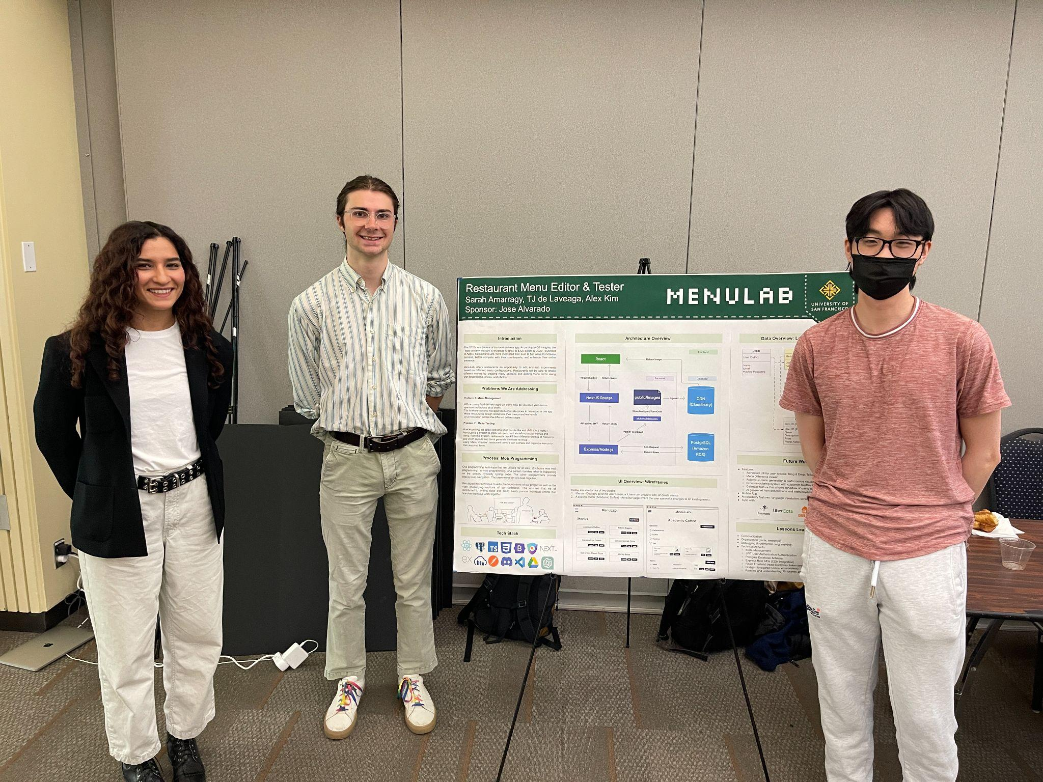
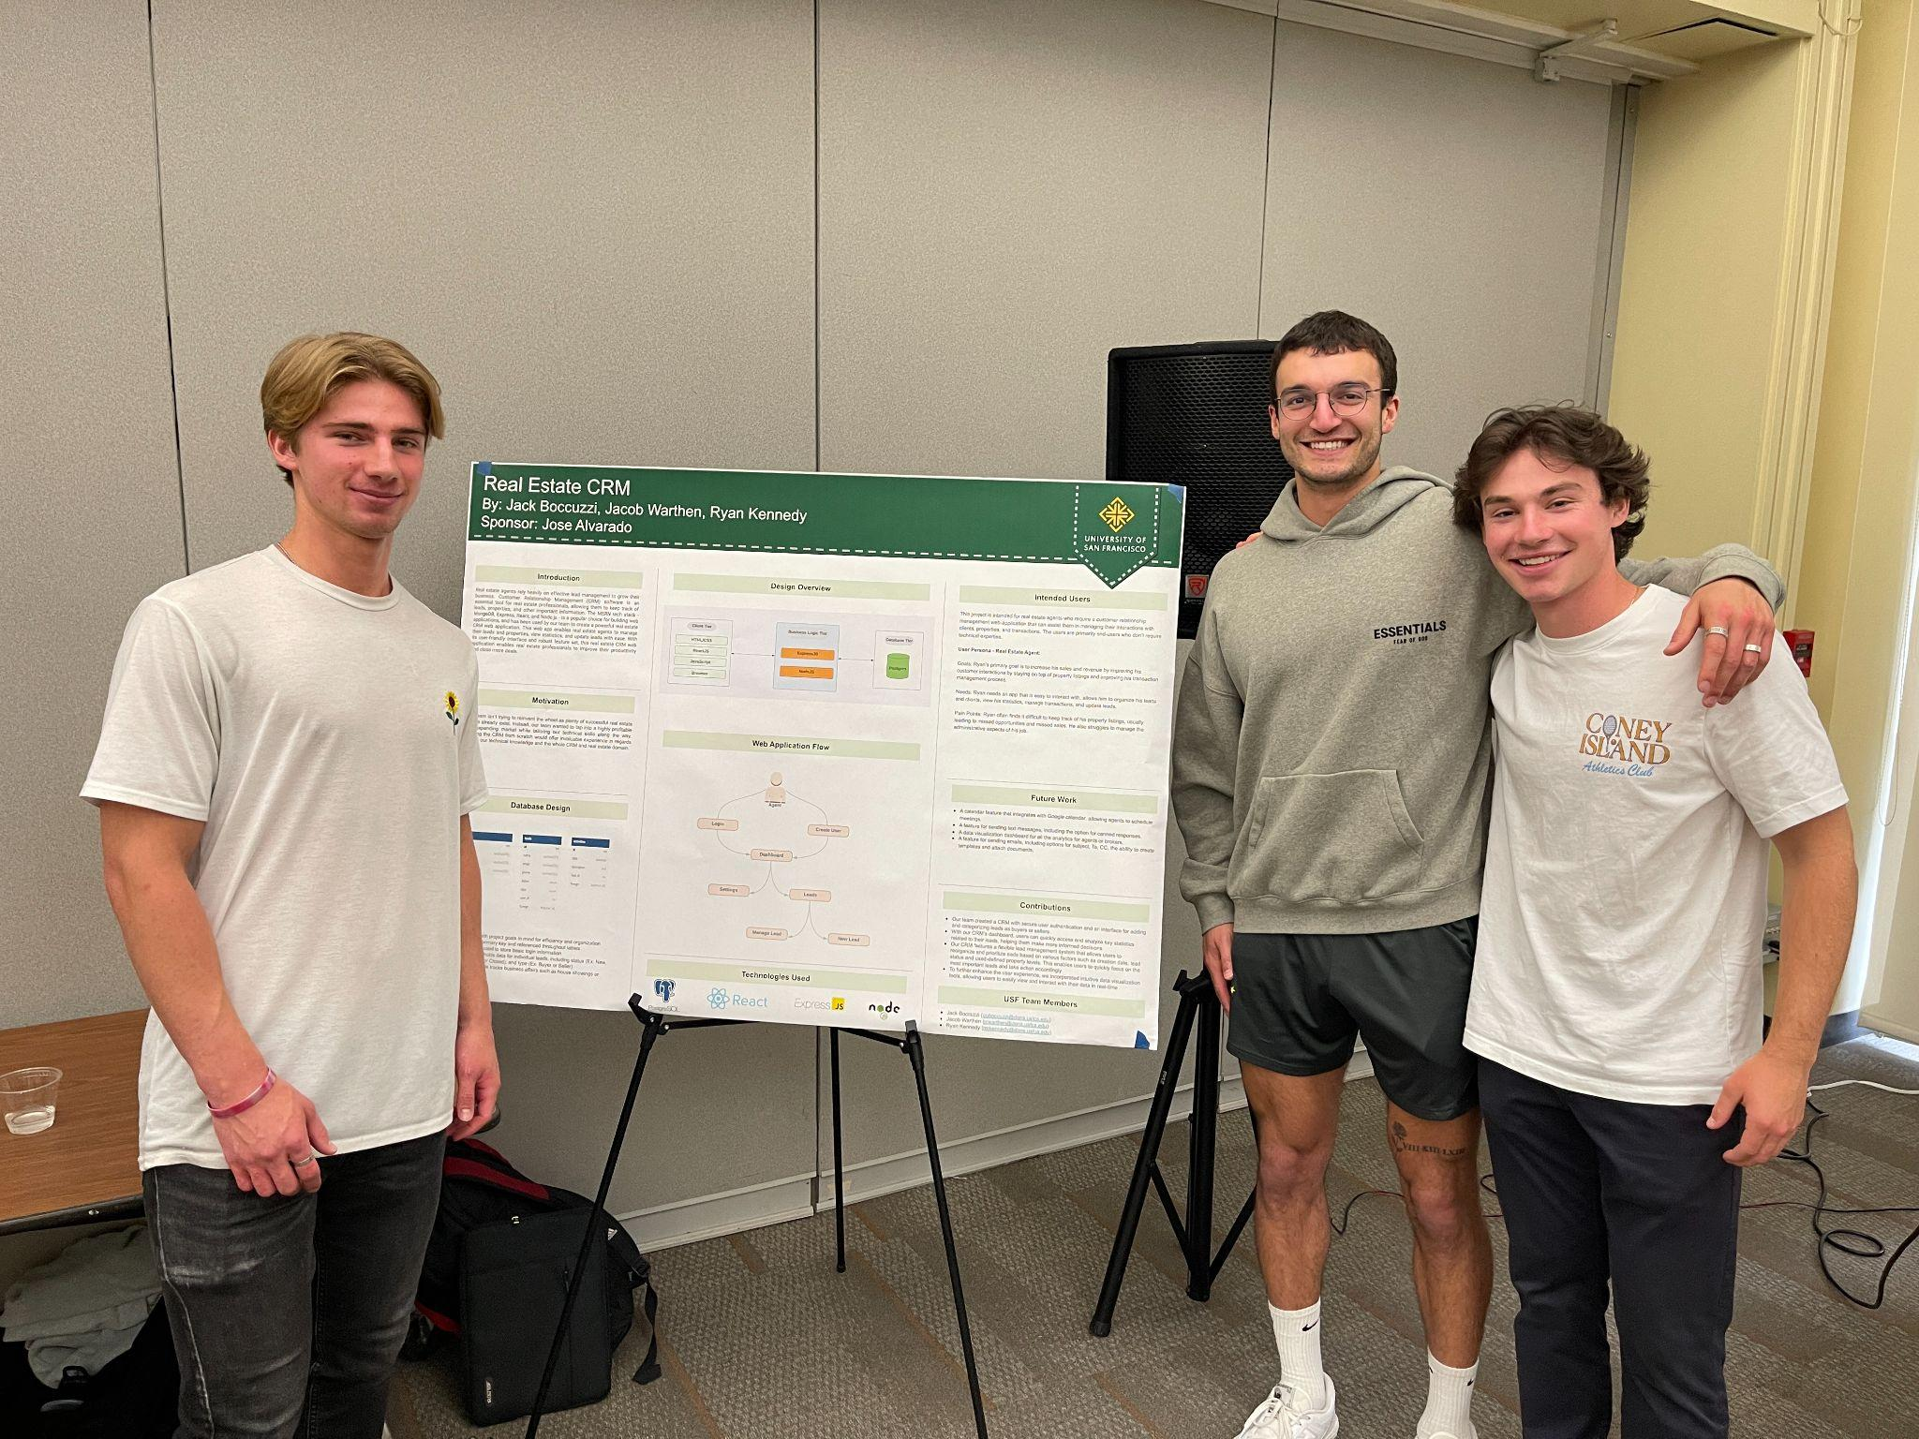
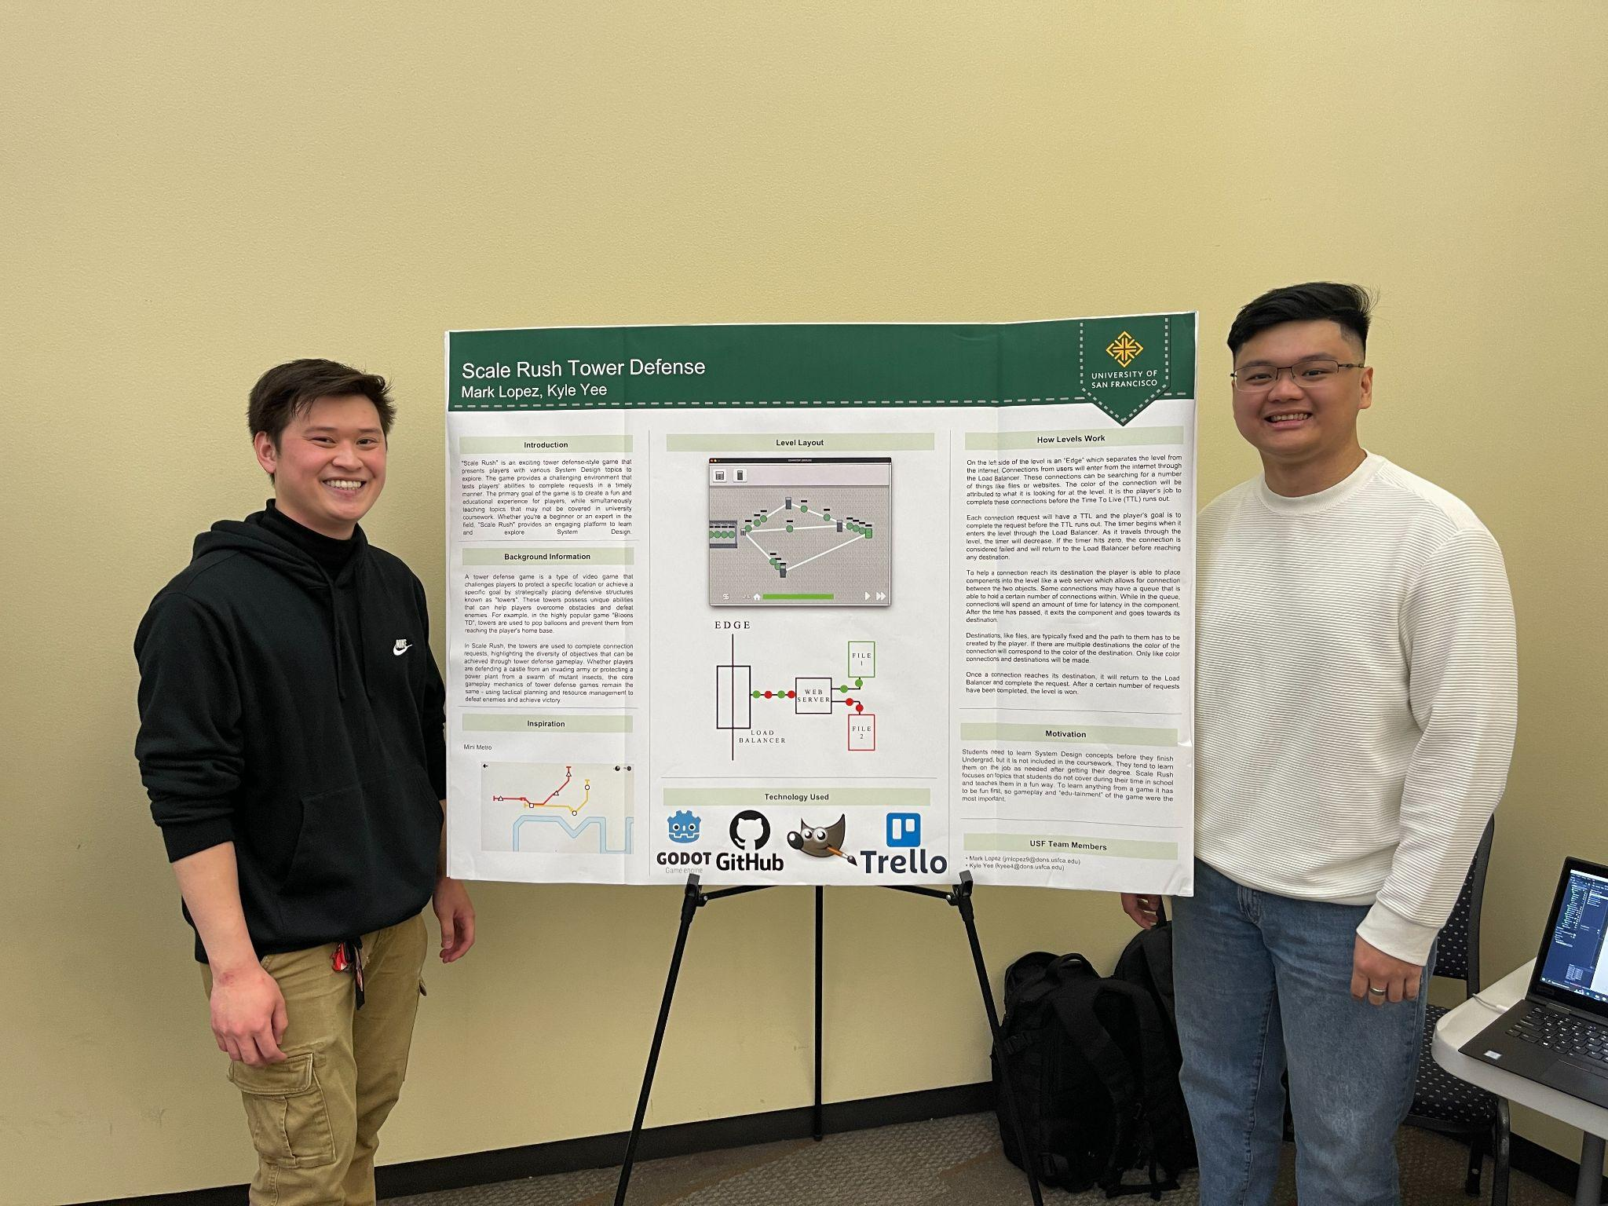
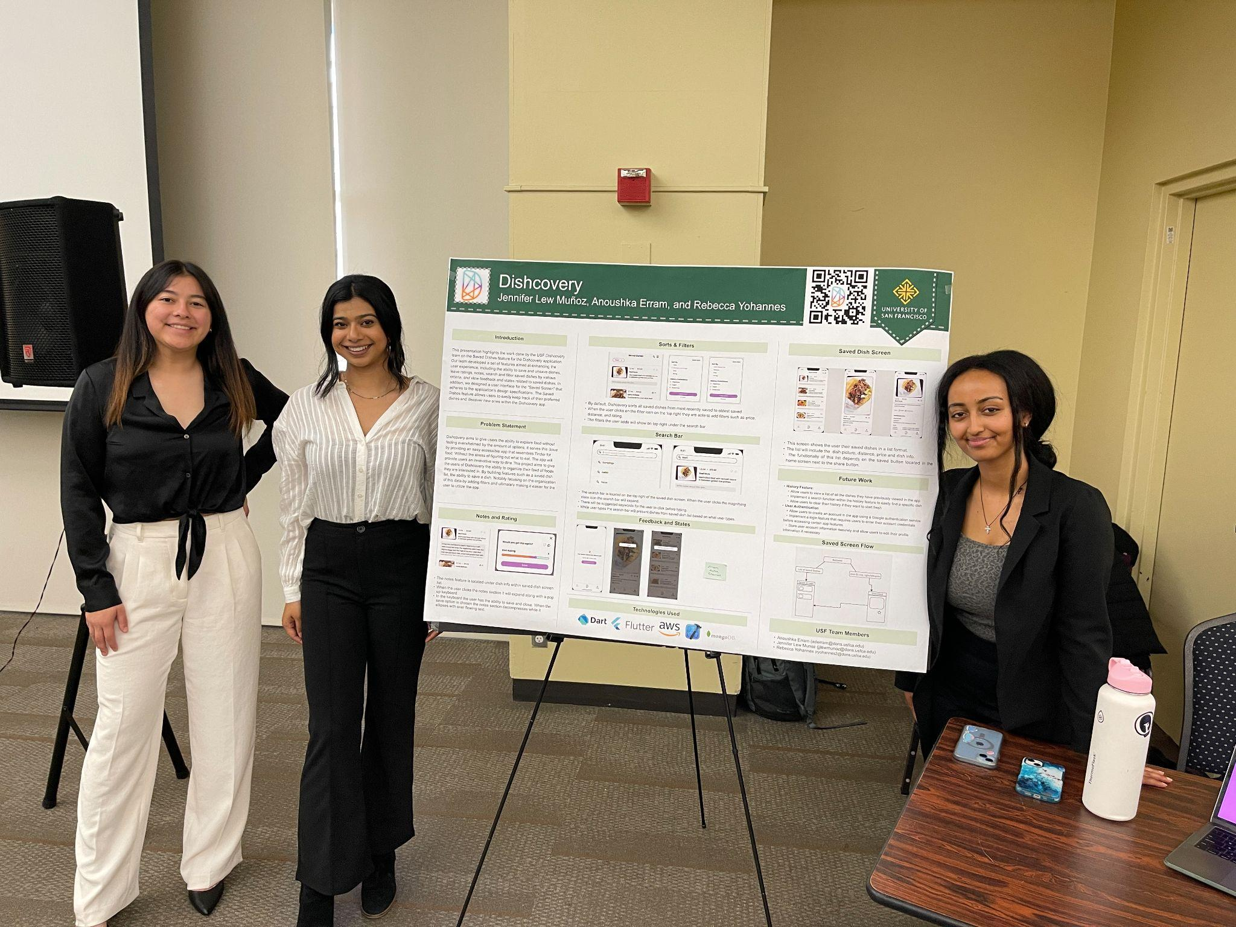
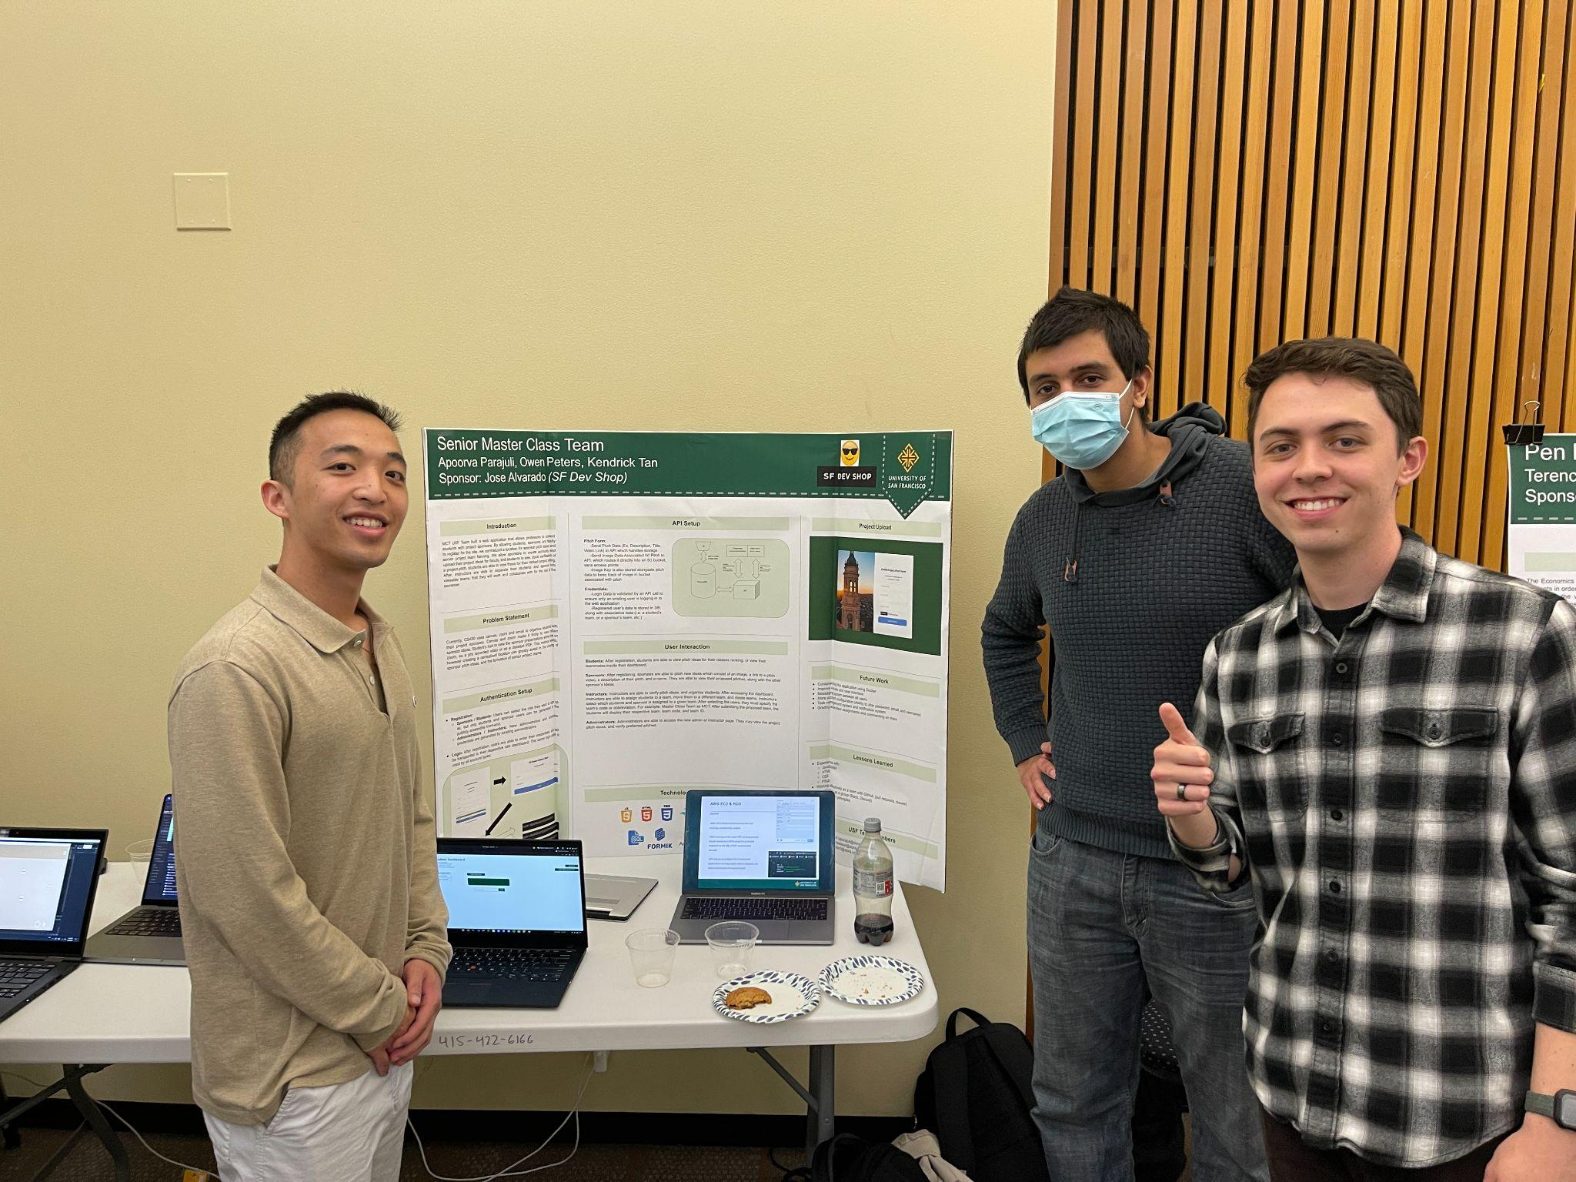
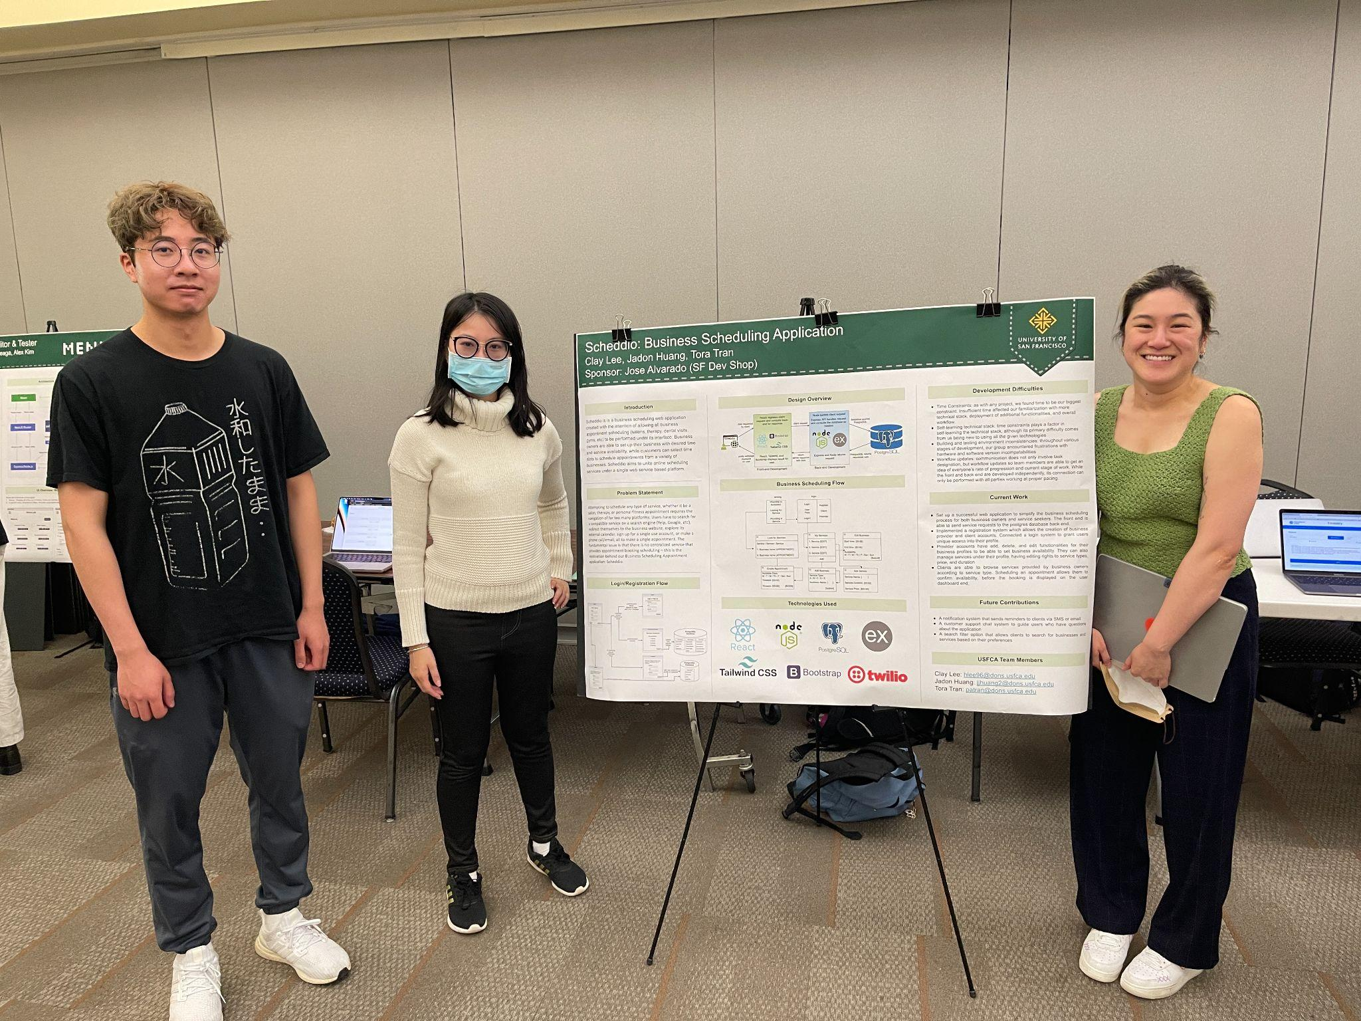
Student Stats
Feb 2017 - Present
Worked with 157 students
46 Projects

Slide 4
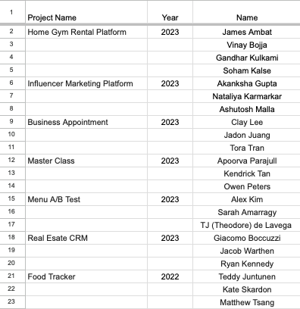
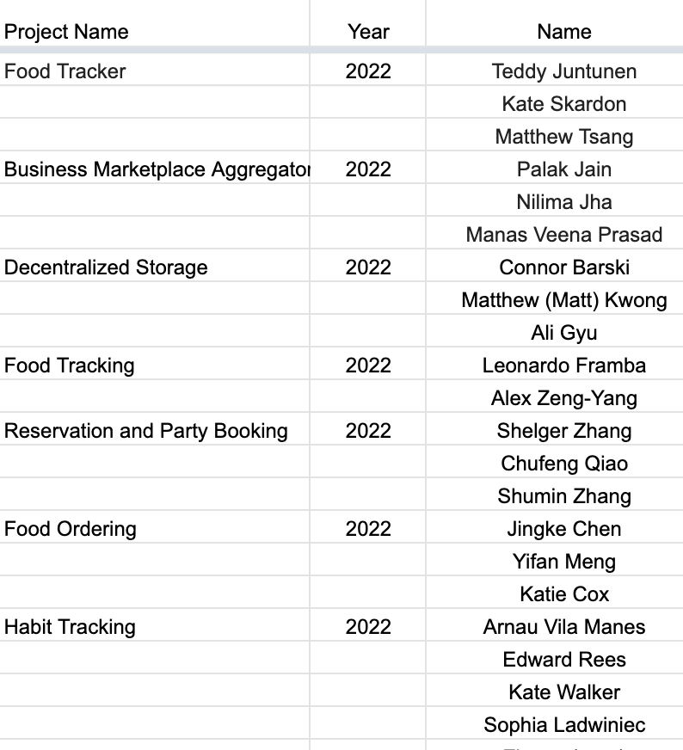
Students I worked with recently

Slide 5
Projects
FinSavvy - Comprehensive Personal Finance Management App (Web)
CollaborateCS - Connecting Students, Professors, and Project Sponsors (Web)
Food Challenge App (Web or Mobile)
ConnectFertility - Affordable Sperm Donation Matching App (Web or Mobile)

Slide 6
Projects
RavePlan - Your Ultimate Rave Experience Organizer (Web)
VoteEase - Secure and User-Friendly Online Voting Platform (Web + Mobile)
TreatTrail - Rediscovering the Traditional Trick-or-Treat Experience (Web + Mobile)
GiftHarbor - Monthly Surprises for Loved Ones (Web + Mobile)

Slide 7
FinSavvy - Comprehensive Personal Finance Management App (Web)
Description:
FinSavvy is an all-in-one personal finance management app designed to cater to both individuals and businesses
With features similar to Mint.com, it categorizes bank transactions, provides insightful summaries, assists in budget creation, and generates user-friendly profit and loss statements for CPA review
This versatile app ensures financial control and planning for users of all backgrounds
Integrate with Plaid to pull transactions from bank accounts
Key Features:
User registration
Income/Expense Tracking
Budgeting
Profit and Loss Statements
Transaction Categorization
Saving Goals

Slide 8
CollaborateCS - Connecting Students, Professors, and Project Sponsors (Web)
Description:
CollaborateCS is a specialized application designed to streamline the connection between professors, computer science students, and project sponsors
This platform facilitates project-based learning by allowing professors to discover and invite sponsors with exciting projects to their classes
Key features include the ability to create virtual classrooms, invite students and sponsors, edit class details, manage assignments and tasks, and facilitate communication through a robust messaging system.
Key Features:
Create profiles for professors, students, and sponsors
Create classrooms
Invite students and sponsors
Edit class information
Add assignments and tasks
View list of projects
Messaging system
Calendar and notification system
Define when sponsors and students meet
Grading and feedback system

Slide 9
Food Challenge App (Web or Mobile)
Description:
The food challenge app encourages users to create, participate in, and share various food challenges, providing a dynamic platform for tracking progress, fostering community engagement, and spurring friendly competition through leaderboards and user-generated challenges
With features such as social sharing, personalized profiles, and a robust feedback system, the app aims to make food challenges enjoyable, interactive, and memorable for users.
Key Features:
User Authentication
Discover challenges
Restaurants
User generated
Comprehensive profile with stats
Leaderboard
Community forum/chat
Feedback and ratings

Slide 10
ConnectFertility - Affordable Sperm Donation Matching App (Mobile + Web)
Description:
ConnectFertility is a revolutionary app designed to make sperm donation and in vitro fertilization more accessible by connecting individuals aspiring to conceive with donors willing to contribute
The platform allows donors to provide detailed profiles, enabling those seeking donors to find suitable matches, engage in conversations, and determine compatibility before embarking on their fertility journey
How much does IVF cost in 2024?
$15K-$30K per cycle
Key Features:
Sign Up / Login
Fill out important information
Upload pictures
Support either swiping or scrolling of profiles
Left swipe does not remove the profile from coming up again in the future
Matches can communicate through the app
Users can unmatch or report a profile
Users will pay a monthly fee to stay active in the app

Slide 11
Round 2

Slide 12
RavePlan - Your Ultimate Rave Experience Organizer (Web)
Description:
RavePlan is the go-to app for avid ravers, offering a seamless platform to plan and enhance their entire rave experience
Users can discover upcoming events, book hotels, and arrange transportation to and from their accommodations, ensuring a stress-free and unforgettable journey into the world of electronic dance music
RavePlan aspires to be the ultimate companion for ravers, offering a one-stop solution for planning, booking, and enjoying immersive and electrifying experiences in the world of electronic dance music
Key Features:
User authentication
Raver profiles
Rave Discovery
Event details
Hotel Integration
Transport Services
Community forum
Ravers can connect, share tips and advice
Review and rating system

Slide 13
VoteEase - Secure and User-Friendly Online Voting Platform (Web + Mobile)
Description:
VoteEase is a cutting-edge online voting website designed to simplify election management, ensuring a seamless experience for both voters and election organizers
With a focus on user-friendly interface, mobile compatibility, security measures, and expertise in ranked voting techniques
VoteEase prioritizes privacy and offers a cost-effective, pay-as-you-go pricing model based on the number of voters
Key Features:
User authentication
Raver profiles
Rave Discovery
Event details
Hotel Integration
Transport Services
Community forum
Ravers can connect, share tips and advice
Review and rating system

Slide 14
TreatTrail - Rediscovering the Traditional Trick-or-Treat Experience (Web + Mobile)
Description:
TreatTrail is a community-focused app designed to revitalize the traditional trick-or-treat experience
It allows enthusiastic Halloween participants to sign up their houses, indicating their commitment to giving away candy and other snacks
To ensure safety, the app incorporates a verification process similar to NextDoor, providing parents with confidence in the authenticity of participating households
TreatTrail aims to bring back the traditional joy of Halloween by creating a digital platform that fosters community engagement and ensures a safe and delightful trick-or-treating experience for children and families
Key Features:
Profile creation
House sign ups
$20 to list their home
Verification process
Interactive maps
Safety guidelines
Community Form
Review system
In app messaging
Event updates

Slide 15
GiftHarbor - Monthly Surprises for Loved Ones (Web + Mobile)
Description:
GiftHarbor is a thoughtful gifting app designed to make it effortless for individuals, starting with husbands, to surprise their wives or girlfriends with monthly gifts
Users create profiles, set preferences, and the app automates the gift-buying process, sourcing trending products, flowers, chocolates, and more from Amazon
The MVP includes the ability to set a monthly spending limit and personalize gifts based on predefined tags or interests.
Future expansions could allow users to create multiple profiles for various recipients, extending the joy of gifting to friends and family.
Key Features:
Profile Creation
Setup tags/interests
Address management
Monthly spending limit
Automated purchases
Notification support
Personalized messages
Occasion reminder
Anniversary

Slide 16
Schedule/Goals
Preferred Tech
Week 1: Intro & Walkthrough
Tutorials
Access to GitHub
Week 2: Backend Tutorials: Node.js
Week 3: Frontend Tutorials: React.js or Swift
Week 4 - 12: Project Tasks
Bi-weekly tasks will be provided based on the number of students in each team and their experience
Weekly standups
Week 13-15:
Wrapping up key features
Poster presentations
Working on extra features if your team is ahead of schedule
Mobile Developer
Swift or Kotlin
React Native or Flutter
Front End Developer
React or Vue
Material-UI, Ant Design
Backend End Developer
AWS
Node.js with Express
Postgres Database
Jamstack SAAS (Advanced)
Chakra UI
Next.js
NestJS
Prisma (Node.js and TypeScript ORM)
NextAuth.js (Authentication for Next.js)
Tailwind CSS

Slide 17
Why should you pick one of my projects?
You will learn enough to apply for a junior software engineering position
Mobile Software Engineer
National Avg. Salary: $127,000
Node.js (API) Software Engineer
National Avg. Salary: $110,000
React.js (Web) Software Engineer
National Avg. Salary: $120,000
Real world experience
Opportunity to give feedback on the product and roadmap
Sprint workshops
Resume Review
LinkedIn Recommendation
Technical Interview Problems + Mock Interviews
No prior experience needed
You will learn the fundamentals as you go
Must have a desire to learn
1-1 help to debug your code
Mentorship beyond USF
Grad School Recommendations
Job references
Resources
Tutorials & courses
Resume
LinkedIn
Connect with Alumni students through our Slack channel
Job Referrals
Public recognition when we launch!

Slide 18
Questions?
Feel free to reach out!
Jose Alvarado <josealvarado111@gmail.com>
Projects: https://www.sfdevshop.com/2024-spring.html

